Slide 1
VA Paper-Based Forms to Enrollment Manager Crosswalk Version 2.0
Updated 2/1/2024

Slide 2
Table of Contents
Table of Contents
Purpose
EM Overview
Enrollment Manager Terminology
Forms By Training Type
IHL
22-1999 Side A
Create a Student
Submit an Enrollment
22-1999b
NCD
22-1999 Side A
Create a Student
Submit an Enrollment
22-1999b
OJT/APP
22-1999 Side B
Create a Student
Submit an Enrollment
22-1999b
22-6553d-1
Flight
22-1999 Side B
Create a Student
Submit an Enrollment
22-1999b
22-6553c
Additional Resources
VA Paper-Based Form to EM Crosswalk
Version History
Date | Version | Description | Authors
02/01/ 2024 | 2.0 | Updated the Crosswalk to correlate with new information in EM, and to reflect the latest Paper Based Webinar Series. | NTT-S
07/21/ 2023 | 1.0 | Initial User Guide for School Certifying Officials to navigate Enrollment Manager. | NTT-S

Slide 3
Purpose
The purpose of this document is to facilitate School Certifying Officials’ (SCOs) transition to Enrollment Manager (EM) by providing a crosswalk between VA paper forms and EM.
A crosswalk is a reference guide that illustrates the relationship between different processes. ​This specific crosswalk instructs users discontinuing paper submissions on how to submit enrollments, changes, and monthly certifications in EM.​
For additional resources on how to use EM, please refer to the EM User Guide located on the Resources for Schools page. SCOs may also access EM training modules specific to their facility type in the SCO Training Portal.
Note: forms included in this presentation are subject to change. Contact your VA representative to access forms in the 22-1999 series, otherwise visit this site.
Return to Table of Contents

Slide 4
EM Overview
EM is the platform for School Certifying Officials (SCOs) that streamlines the enrollment process.
Using EM, SCOs can do the following:
Create shared student/trainee records between VA and EM
Find and add a student/trainee to a facility
View student/trainee information​
Submit student/trainee certifications
Add notes to a student’s/trainee’s profile and to their enrollment
Permanent VA Exemptions:
VA will continue to accept paper enrollments via mail or Ask VA (AVA) for the following programs/ training types as they are not supported by EM:
VR&E OJT/APP Certifications
High schools
Facilities permitted to teach-out of existing students
Students without SSN
Correspondence Training
Chapter 32
Return to Table of Contents

Slide 5
Enrollment Manager Terminology

Slide 6
EM Terminology
Labels | Definition
Statuses
In progress | Enrollment/Amendment/Certification in draft state.
Pending SCO Review | Draft entered by an Assistant must be verified and submitted by School Certifying Officials.
Submitted | Enrollment/Amendment/Certification was sent for processing.
Processed Not applicable for OJT/APP and Flight | Enrollment/Amendment/Certification has been reviewed. EM will continue to display “Under Review” even after it has been processed for all OJT/APP and Flight enrollment certifications.
Terminology
School, Institution, Facility | Includes all Institutions of Higher Learning (IHLs) and nontraditional training/education courses and programs.
Assistant (SCO Assistant, Certifying Official Assistant, School Certifying Official Assistant) | Assistants have full access to a student's profile such as the Enrollments, Student Info, Programs, Benefits, History, Notes and the Reports tab. They can enter data in EM but cannot submit trainee enrollment information to the U.S. Department of Veterans Affairs (VA). Assistants are not listed on the VA Form 22-8794 and are not required to complete SCO training. New Assistants are granted access to EM by their facility-designated School Certifying Official (SCO).
Return to Table of Contents

Slide 7
EM Terminology cont.
Labels | Definition
Terminology
School Certifying Official Read Only (Read-only Users, Read Only SCO, Read Only Certifying Official) | SCO Read Only users are representatives with permission to access training information, request information from VA, and submit inquiries to VA to assist an authorized designated SCO with obtaining accurate information to certify a student’s enrollment. They must be listed on the VA Form 22-8794, but they do not need to complete SCO training. SCO Read Only users cannot certify a student’s enrollment to VA.
Student, Trainee | Individual using their GI Bill benefits to pursue educational programs, training, certifications, etc.
Program | Student’s chosen path of study that is pursued at a school or training facility. ​
Preset Enrollments | Term dates on approved school calendar that can be prepopulated.
Online Credits | Web-based learning using one or more technologies to deliver instruction to students.
Amendment | Any change made to an enrollment after it is submitted; however, for OJT/APP and Flight enrollment certifications corrections, do not use the “Amend” button if any monthly certifications have been submitted to VA. Any required changes to a Monthly Certification should be reported in a Custom Remark on a subsequent Monthly Certification.
Vacation Period | The dates of official school vacation periods which are 7 or more consecutive days. Used when certifying non-standard enrollment periods for all benefits. Vacation period dates can be preset.
Return to Table of Contents

Slide 8
Forms by training type
Navigate to the appropriate forms and their relevant crosswalk to EM by selecting the hyperlinked text or navigate to the corresponding page number:
Institutions of Higher Learning - Navigate to Page 10
Non-College Degree Programs - Navigate to Page 35
On-the-Job Training / Apprenticeship - Navigate to page 60
Flight - Navigate to page 91
Return to Table of Contents

Slide 9
Institutions of Higher learning (IHL)
Access the appropriate form and its relevant crosswalk to EM by selecting the hyperlinked section below or navigating to the corresponding page number.
Form 22-1999 Side A – VA Enrollment Certification – Navigate to page 11
Create a Student – Navigate to page 14
Submit an Enrollment – Navigate to page 20
Form 22-1999b – Notice of Change in Student Status – Navigate to page 27
Return to Table of Contents

Slide 10
IHL VA Form 22-1999 Side A – VA Enrollment Certification
Return to Table of Contents

Slide 11
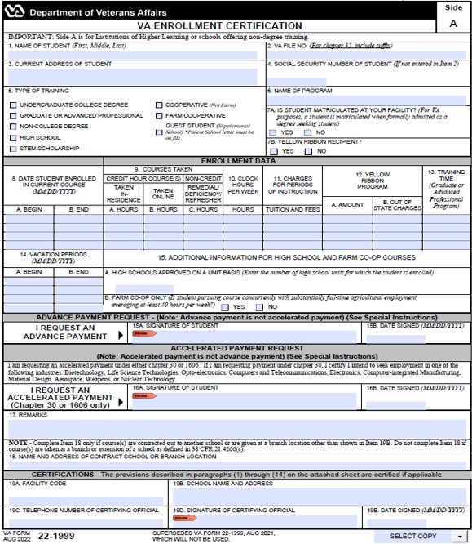
VA Form 22-1999 Side A to EM Overview
In EM, you need to first find the student or create a record for the student in the system before you can add an enrollment. The following sections aligns VA Form 22-1999 Side A to how these actions are completed in EM.
Submitting Enrollments
Creating a Student
A
B
The process for submitting enrollment certifications in EM. Navigate to page 11 to view the crosswalk for instructions on submitting enrollments for IHL institution types in EM.
The process of entering a student’s biographical and program information into EM. SCOs only create a student if the student cannot be found in a search. Navigate to the EM User Guide on the Resources for Schools page to learn how to search for a student.
E
C
D
Student Information
Begin and End Date for Courses
Credit or Clock Hours
Tuition and Fees
Vacation Period
Notes
SCO Certification
Name of Student, Current Address
Social Security Number (SSN) and/or VA File Number
Type of Training
Matriculated Student
Name of Program
Applicable to both Submitting Enrollments and Creating a Student

Slide 12
IHL: Changes – 1999 Side A Amendments vs 1999b Adjustments
Term Date changes using Paper Form Amendments
Previously, SCOs used a blank form and write the appropriate information and include new dates (e.g., 5/19/23 changed to 5/10/23).
Then, the SCO submitted a new form with updated dates.
Changes to a Student’s Enrollment Status using Paper Form Adjustments
Previously, the SCOs selected:
“Reason for termination” checkbox in the “Termination” section or
“Type of adjustment” checkbox in the “Adjustment of Credit or Clock Hours” section.
Term Date Amendments changes using EM
Now, if term dates need to be corrected, navigate to the previously submitted enrollment and select the “Amend” button.
On this page, select the calendar icon and select the appropriate dates.
Submit the amendment to finalize this process.
Changes to a Student’s Enrollment Status using an Amendment EM
Now, if a student’s status needs to change, navigate to the previously submitted enrollment and select the “Amend” button.
On the next screen, make any needed changes to the editable fields.
Submit the amendment to finalize this process.

Slide 13
IHL VA Form 22-1999 Side A – VA Enrollment Certification Creating a Student
Return to Table of Contents
Return to Start of IHL Section

Slide 14
IHL: VA Form 22-1999 Side A vs EM – Creating a Student
This section outlines how to create a student before submitting an enrollment certification. SCOs only create a student if they are not in the EM system. Navigate to the EM User Guide on the Resources for Schools page to learn how to search for a student.
Begin with the table below to identify the task as it is completed using VA Form 22-1999 Side A and how the task is completed in EM. Each lettered task aligns with the letters in the pages that follow.
# | Task | Form 22-1999 Side A | EM-IHL
A | Student Information | SCOs wrote a student’s name and current address on the form. | SCOs type the student’s “First name,” “Middle name,” and “Last name.” EM asks for additional information, including, “Date of Birth,” “Student ID,” “Mobile phone number,” “Home phone number,” and “Email address.” Not all fields are required. SCOs scroll down the page to select the “Address type” dropdown menu to select the type of address.
B | SSN of Student | SCOs wrote the student’s SSN. | SCOs type the student’s SSN.
C | Type of Training | SCOs checked off the type of training. | SCO’s select the dropdown menu to select the type of training.
D | Matriculated Student | SCOs checked off “yes” or “no” to indicate whether the student matriculated at a facility. | SCOs select the dropdown menu to select the type of Objective.
E | Name of Program | SCOs wrote the student’s name of Program. | SCOs select the dropdown menu to select the Program name.
Return to Table of Contents
Return to Start of IHL Section

Slide 15
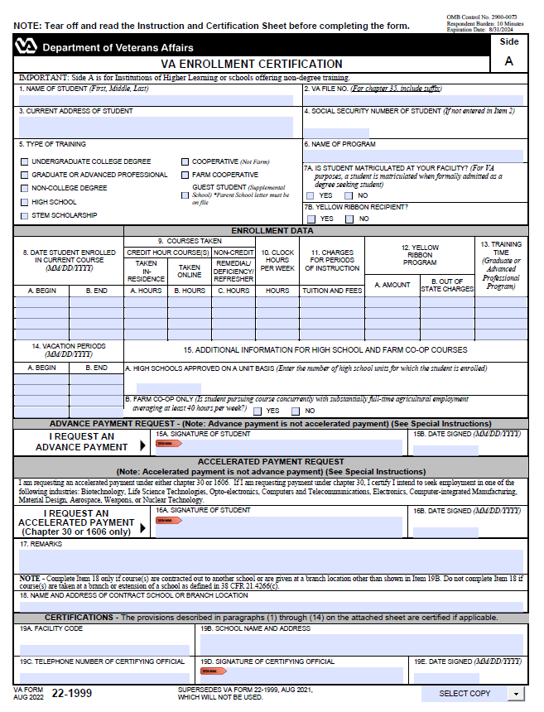
IHL: VA Form 22-1999 Side A to EM
The following section aligns with VA Form 22-1999 Side A actions for Creating a Student in EM.
A
B
E
Creating a Student
C
D
Please note the following while reviewing this VA Form:
“CTRL” + select the number associated with the field to navigate to the updated functionality in EM.
VA File Numbers (Box 2 on 22-1999) are only used when creating a new Chapter 35 trainee. VA File Numbers can only be viewed when completing the actions to print a certification.
Social Security numbers (SSNs) (Box 4 on 22-1999) are only used when creating a new student. SSNs cannot be edited or searched in EM. SSNs can only be viewed when printing the certification.
Return to Table of Contents
Return to Start of IHL Section

Slide 16
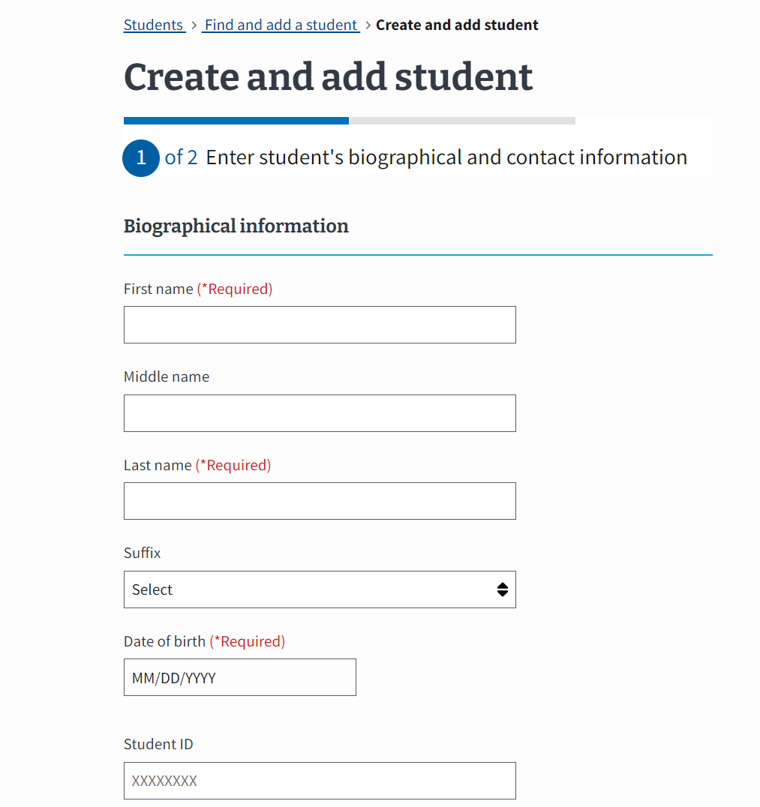
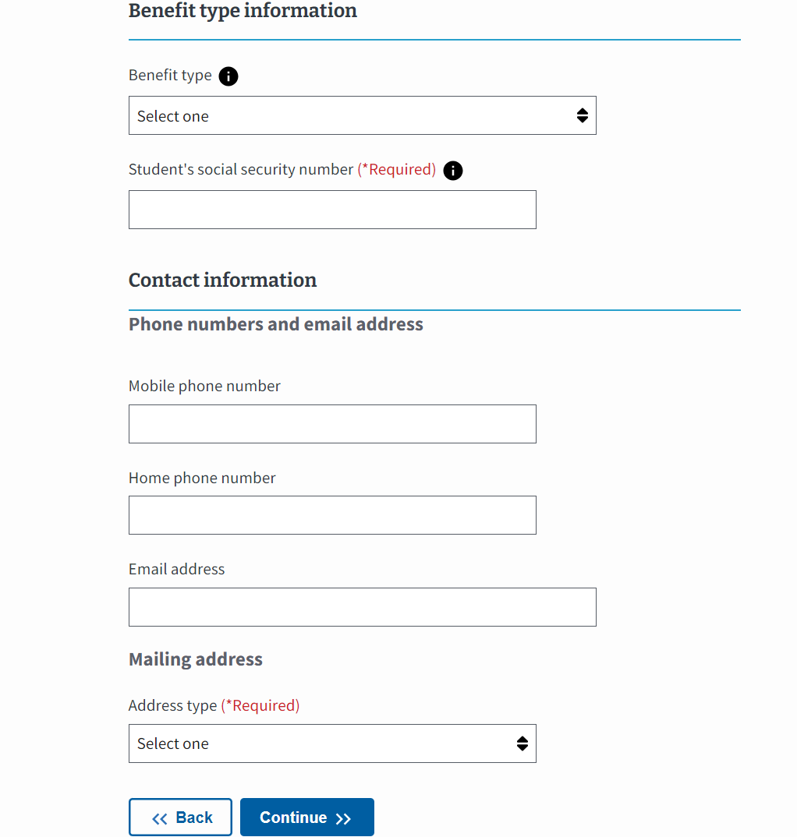
IHL: EM View of Creating a Student
To learn how to navigate to the Student Profile, go to the EM User Guide on the Resources for Schools page. If the student is not in EM, they need to be created.
In EM, there is a field to include the student’s “Benefit type.” Your student provides this information.
A.
Type the student’s “First name,” “Middle name,” and “Last name.”
EM asks for additional information, including “Date of Birth,” “Student ID,” “Mobile phone number,” “Home phone number,” and “Email address.” Not all fields are required.
Scroll down the page to select the “Address type” dropdown menu to select the type of address.
A
B
B.
Type the student’s SSN.
A
Select the “Continue” button to move to the next page.
Return to Table of Contents
Return to Start of IHL Section

Slide 17
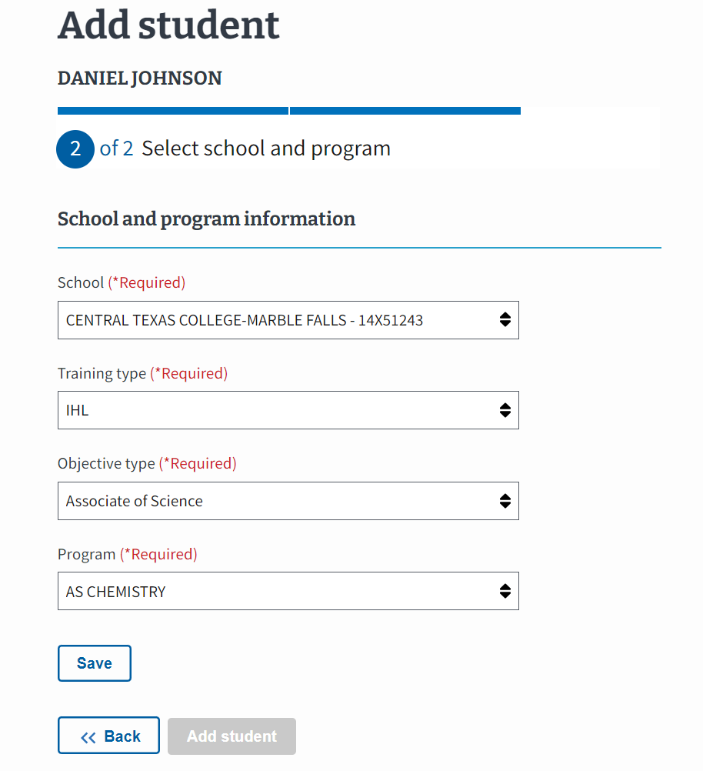
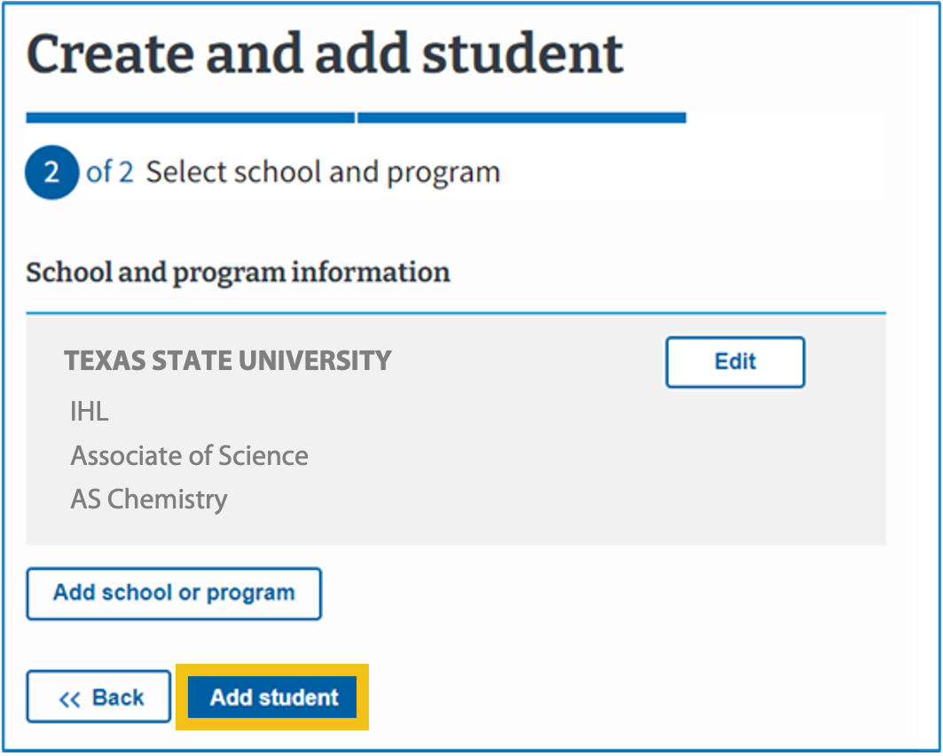
IHL: EM View of Creating a Student (Continued Part 1)
Select the School the student is enrolled at. The dropdown contains the SCO’s assigned facilities.
C.
Select the dropdown menu to select the type of training.
C
D.
Select the “Objective type.” This dropdown contains the various degrees or certificates available at the selected facility.
D
E
E.
Select the dropdown menu to select the Program name.
Select “Save.”
Select “Add student.”
Return to Table of Contents
Return to Start of IHL Section

Slide 18
IHL: EM View of Creating a Student (Continued Part 2)
The student’s information is now available in EM. From here, you will be able to add an enrollment.
Return to Table of Contents
Return to Start of IHL Section

Slide 19
IHL VA Form 22-1999 Side A – VA Enrollment Certification Submitting an Enrollment
Return to Table of Contents
Return to Start of IHL Section

Slide 20
IHL: VA Form 22-1999 Side A vs EM – Submitting an Enrollment
This section outlines how to submit an enrollment certification. Begin with the table below to identify the task as it is completed using VA Form 22-1999 Side A and how the task is completed in EM. Each numbered task aligns with the numbered items in the pages that follow.
# | Task | VA Form 22-1999 Side A | EM – IHL
1 | Student Information | SCOs wrote a student’s name and current address on the form. | Located at the top of the screen, EM displays the student’s name after the student is created and/or searched and the user navigates to that profile. The student’s address is located on the right-hand bottom side of the screen.
2 | Begin and End Date for Courses | SCOs wrote the begin and end date for the courses a student was taking. | SCOs select the calendar icon to select the appropriate begin and end dates for student courses. SCOs may use preset enrollment dates to automatically fill in the begin and end dates.
3 | Credit Hours | SCOs wrote the number of credit or clock hours for each type of course taken. | SCOs type the numerical values for the number of credit or clock hours for each type of course.
4 | Tuition and Fees | SCOs wrote the tuition and fees when required. | SCOs type the tuition and fees in EM when required.
5 | Vacation Period | SCOs wrote the vacation period data. | SCOs select the “Vacation period” button and populate the necessary data. Preset vacation dates can be selected in EM.
6 | Remarks | SCOs wrote remarks concerning a student. | SCOs add a VBA remark if needed. The selection of some VBA remarks require providing additional information. SCOs should use the "Notes" section to capture student and school specific information. Notes are not sent to VA with the enrollment but can be reviewed by VA, if necessary.
7 | SCO Certification | SCOs certified enrollment by signing and then submitting the completed form to VA. | SCOs select the “Submit enrollment” button to transmit the enrollment to VA or select the “Save as draft” button.
Return to Table of Contents
Return to Start of IHL Section

Slide 21
IHL: VA Form 22-1999 Side A
The following section aligns with VA Form 22-1999 Side A actions for Submitting an Enrollment in EM.
Submitting Enrollments
Please note the following while reviewing this form:
“CTRL” + select the number associated with the field to navigate to the updated functionality in EM.
VA File Numbers (Box 2 on 22-1999) are only used when creating a new Chapter 35 trainee. VA File Numbers can only be viewed when completing the actions to print a certification.
Social Security numbers (SSNs) (Box 4 on 22-1999) are only used when creating a new trainee. SSNs cannot be edited or searched in EM. SSNs can only be viewed when printing the certification.
Yellow Ribbon and % eligibility is shown on the Benefits tab of a Student’s Profile and is inputted by VA. If the student is 100% eligible, the SCO can select Yellow Ribbon Recipient (Box 7b and 12 on 22-1999) when creating an enrollment.
Return to Table of Contents
Return to Start of IHL Section

Slide 22
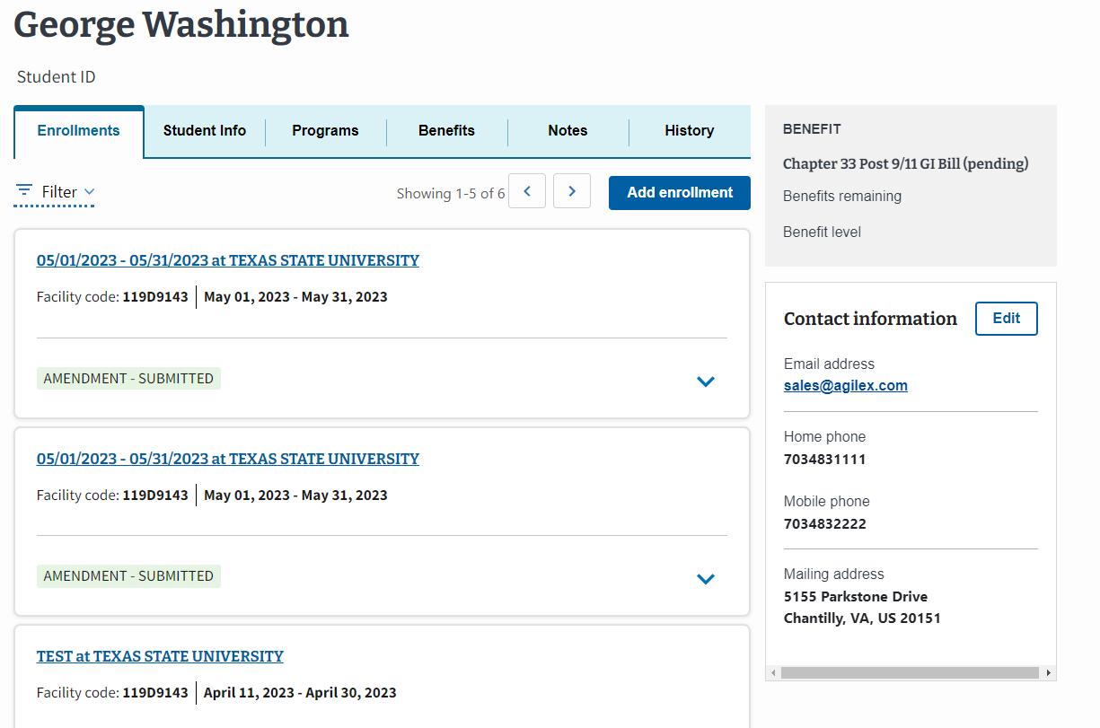
IHL: EM View of Submitting an Enrollment
To learn how to navigate to the Student Profile, go to the EM User Guide on the Resources for Schools page.
To create an enrollment for a student, select the “Add enrollment” button.
1.
Located at the top of the screen, EM displays the student’s name once the student is created and/or found in EM and you navigate to that Student’s profile.
The student’s address is located on the right-hand bottom side of
the screen.
Note: SCOs can add multiple enrollments at once by selecting the "Add multiple enrollment" button or add one enrollment by selecting "Add one enrollment" button.
Return to Table of Contents
Return to Start of IHL Section

Slide 23
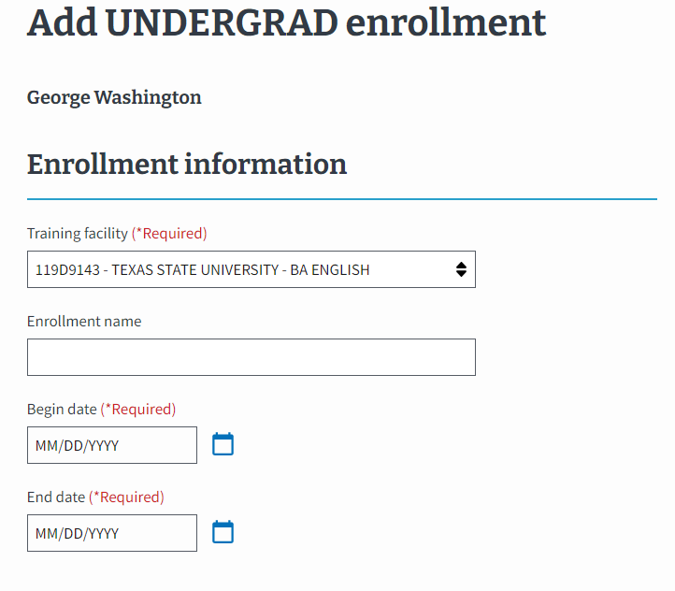
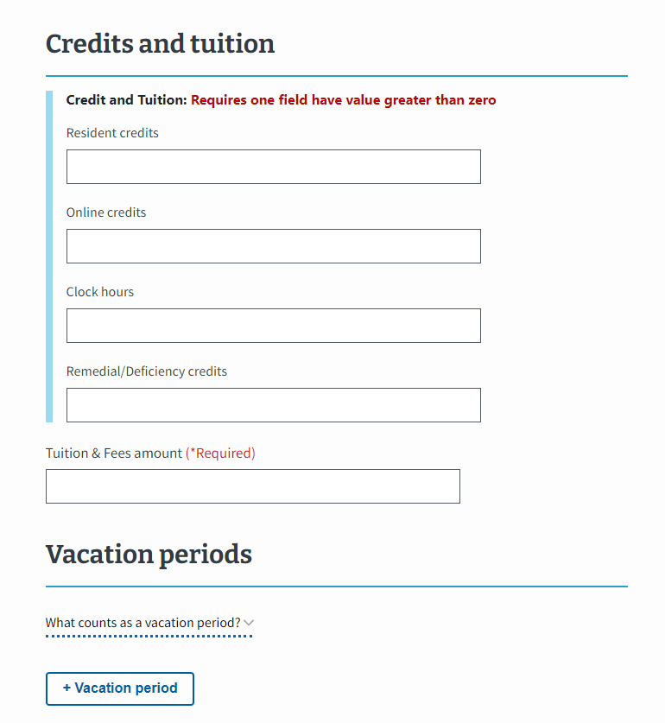
IHL: EM View of Submitting an Enrollment (Continued 1)
2.
Select the Training facility from the dropdown. Use the “Enrollment name” field to select a pre-entered preset enrollment from dropdown (optional) or type in a name.
Select the calendar icon to choose the “Begin date” and “End date” for student courses if preset enrollment dates were not used.
3.
Type the numerical values for the type of credit or clock hours.
4.
Type the tuition and fees in EM when required.
Return to Table of Contents
Return to Start of IHL Section

Slide 24
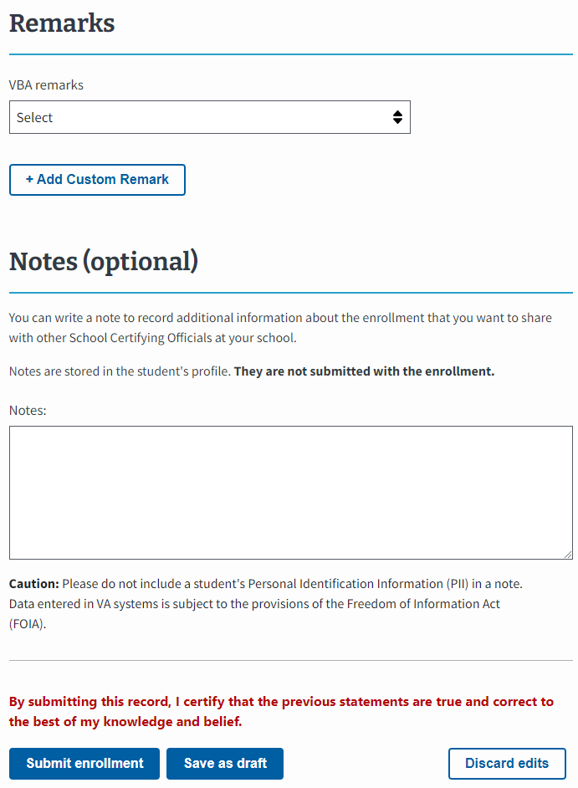
IHL: EM View of Submitting an Enrollment (Continued 2)
5.
Select the “Vacation period” button and populate the field when appropriate. Preset vacation dates can be selected in EM.
6.
Choose to add a VBA remark if needed. The selection of some VBA remarks require providing additional information.
Use the "Notes" section to capture student and school specific information. Notes are not sent to VA with the enrollment but can be reviewed by VA, if necessary.
7.
Select the “Submit enrollment” button to transmit the enrollment to VA or select the “Save as draft” button.
Return to Table of Contents
Return to Start of IHL Section

Slide 25
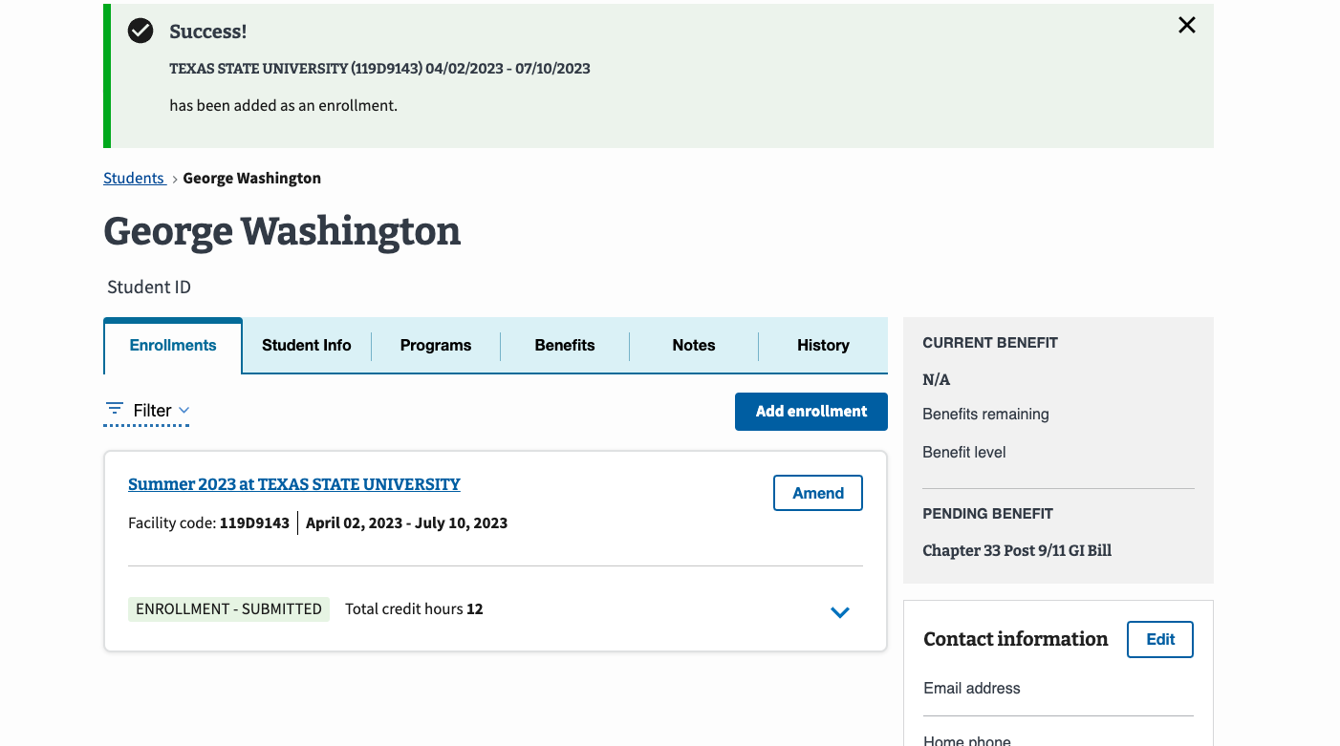
IHL: EM View of Submitting an Enrollment (continued 3)
A Success banner displays once the amendment has been successfully submitted.
Return to Table of Contents
Return to Start of IHL Section

Slide 26
IHL VA Form 22-1999b – Notice of Change in Student Status
Return to Table of Contents
Return to Start of IHL Section

Slide 27
IHL: VA Form 22-1999b vs EM Functionality
This section outlines how to amend an enrollment. Begin with the table below to identify the task as it is completed using VA Form 22-1999b and how the task is completed in EM. Each numbered task aligns with the numbered items in the pages that follow.
# | Task | VA Form 22-1999b | EM – IHL
1 | Student Information | SCOs wrote a student’s name and current address on the form. | Located at the top of the screen, EM displays the student’s name after the student is created and/or searched and the user navigates to that profile. The student’s address is located on the right-hand bottom side of the screen.
2 | Termination Information/Amendment Reason | Termination: SCOs selected the adjustment reason checkbox and entered the last date of attendance in the Termination section. Other sections require completion. Adjustment: SCOs selected the appropriate adjustment reason checkbox and provided the effective date in the Adjustment section. Other sections require completion. | SCO selects the “Amend” button on the enrollment. Termination: SCOs select the “Termination” box on the Amend enrollment page. Graduation: SCOs select the “Graduation/End of Term of Course” box on the Amend enrollment page. Amend: SCOs make the appropriate updates to otherwise amend an enrollment. These changes trigger new fields to appear. SCOs select the appropriate “Amendment Reason” from the dropdown. Depending on the selected reason, the SCO may need to provide more information (e.g., Amendment effective date).
3 | Credit Hours Adjustment | SCOs wrote the updated numerical values in the credit or clock hours section. | SCOs increase or decrease the numerical values in the “Credits and tuition section” in EM.
4 | Remarks | SCOs wrote remarks concerning a student. | SCOs add a VBA remark if needed. The selection of some VBA remarks require providing additional information. SCOs should use the "Notes" section to capture student and school specific information. Notes are not sent to VA with the enrollment but can be reviewed by VA, if necessary.
5 | SCO Certification | SCOs completed the form by certifying it by writing the appropriate information. | SCOs select the “Submit amendment” button to transmit the amendment to VA or select the “Save as draft” button.
Return to Table of Contents
Return to Start of IHL Section

Slide 28
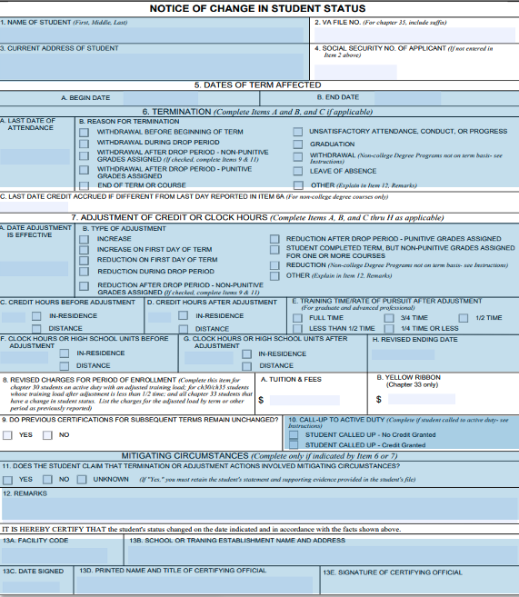
IHL: VA Form 22-1999b to EM
This image represents the fields completed by SCOs when submitting paper adjustments (any change in student status) for Institutions of Higher Learning.
Please note the following while reviewing this form:
“CTRL” + click the number associated with the field to navigate to the updated functionality in EM.
VA File Numbers (Box 2 on 22-1999b) are only used when creating a new Chapter 35 trainee. VA File Numbers can only be viewed when completing the actions to print a certification.
Social Security numbers (SSNs) (Box 4 on 22-1999b) are only used when creating a new trainee. SSNs cannot be edited or searched in EM. SSNs can only be viewed when printing the certification.
If an SCO is ending an enrollment for a student that has subsequent enrollments (Box 9 on 22-1999b), an automatic prompt is triggered in EM asking if these enrollments should also end.
Return to Table of Contents
Return to Start of IHL Section

Slide 29
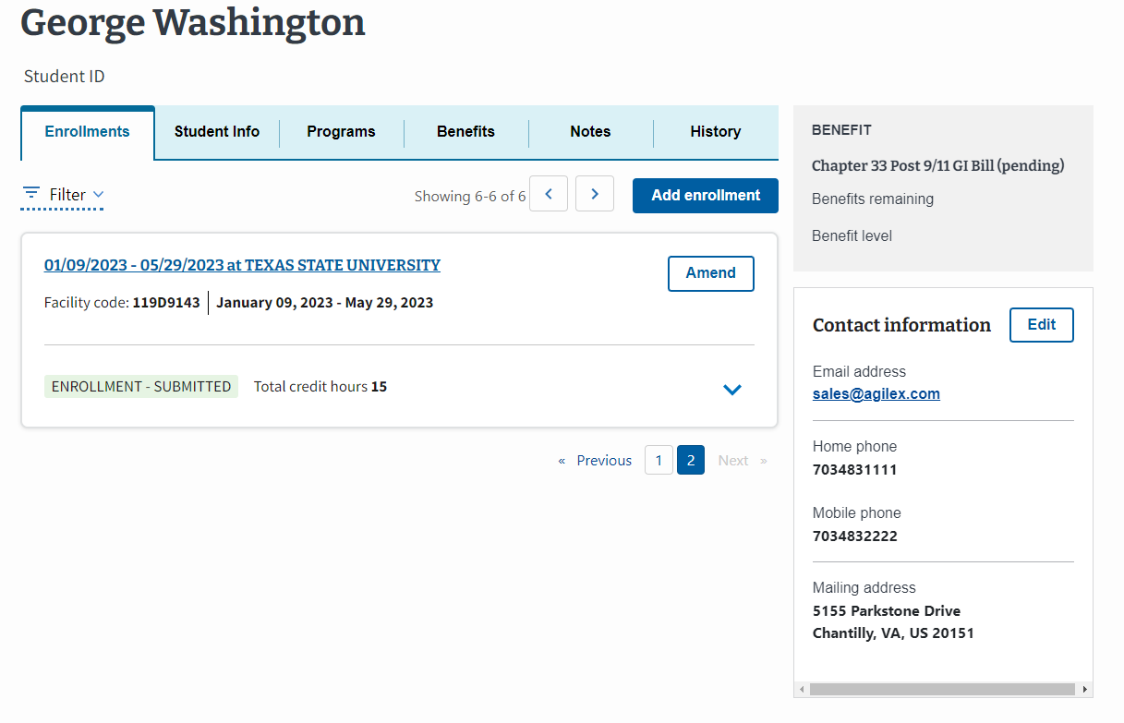
IHL: EM View of Amending an Enrollment
To learn how to navigate to the Student Profile, go to the EM User Guide on the Resources for Schools page.
To amend an enrollment for a student, select the “Amend” button.
1.
Located at the top of the screen, EM displays the student’s name once the student is created and/or found in EM and you navigate to that Student’s profile.
The student’s address is located on the right-hand bottom side of the screen.
Return to Table of Contents
Return to Start of IHL Section

Slide 30
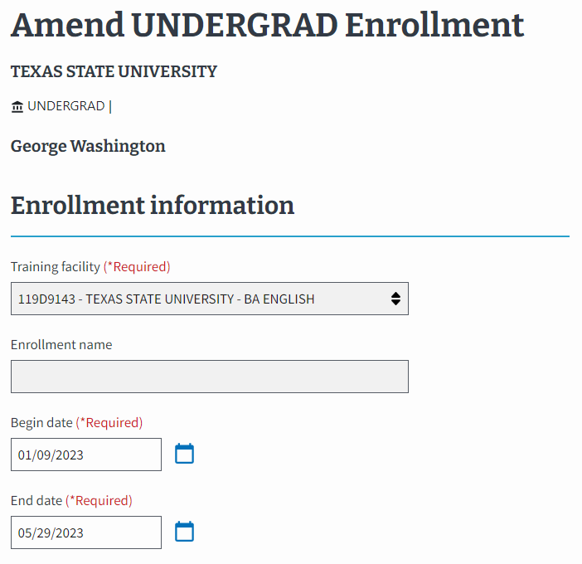
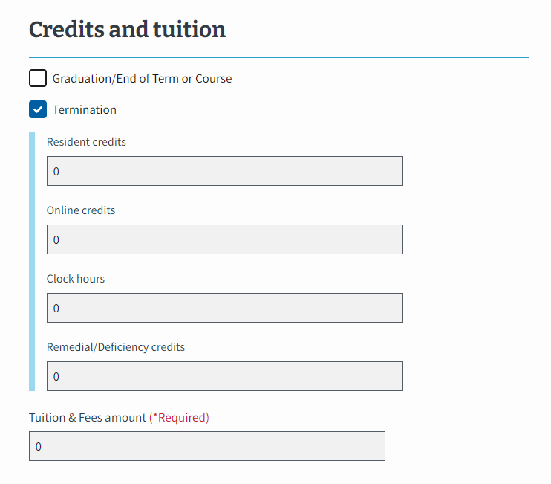
IHL: EM View of Amending an Enrollment (Continued 1)
2.
Select the:
“Termination” check box if the student has withdrawn (shown in the example). All values in section 3 will zero out and become non-editable.
“Graduation/End of Term or Course” check box if the student has graduated or completed their program. All values in section 3 become non-editable.
Select neither to amend different components of the enrollment. This keeps the fields in Step 3 editable.
3.
Increase or decrease the numerical values in the “Credits and tuition section” if you are not terminating the enrollment or graduating the student.
Return to Table of Contents
Return to Start of IHL Section

Slide 31
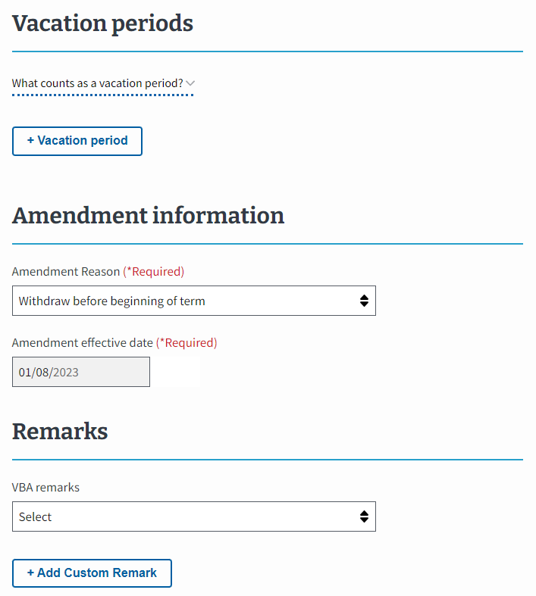
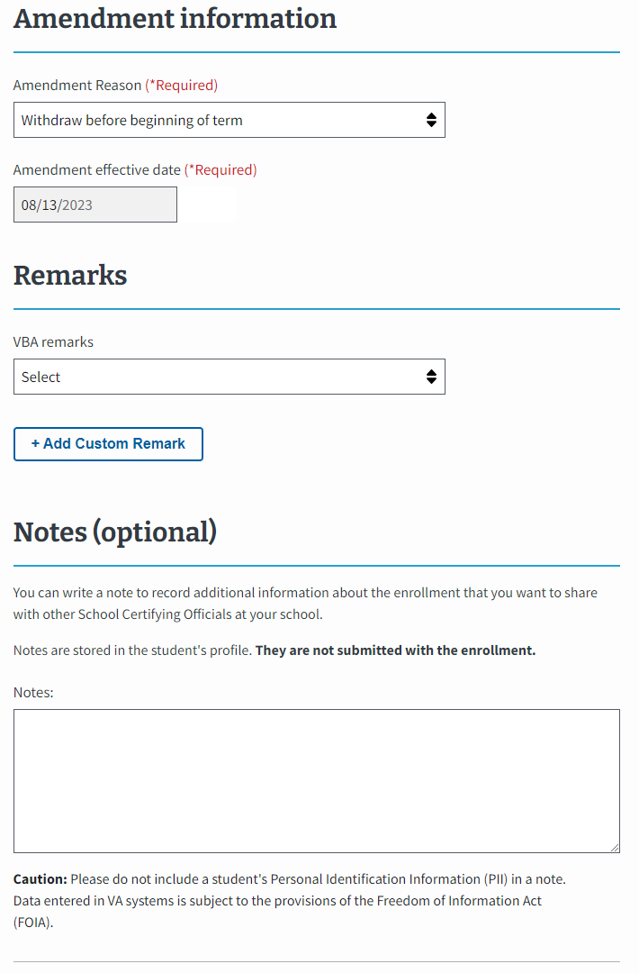
IHL: EM View of Amending an Enrollment (Continued 2)
Note: The steps are not out of order. Please continue completing the actions as shown.
2. and 3.
Select the “Amendment Reason” dropdown menu to select the appropriate reason for amending. The options available differ based on inputs in step 2 and 3 of the previous slide. Then, enter the Amendment effective date.
Note: if the “Withdraw after drop period – non-punitive grades assigned”, which is a typical termination, or “Reduction after an add drop period -non-punitive grades assigned” for the “Amendment Reason” is selected, then the Mitigating Circumstances (Optional) field appears.
4.
Add a VBA remark if needed. The selection of some VBA remarks require providing additional information.
Use the "Notes" section to capture student and school specific information. Notes are not sent to VA with the enrollment but can be reviewed by VA, if necessary.
5.
Select the “Submit amendment” button to transmit the amendment to VA or select the “Save as draft” button.
Return to Table of Contents
Return to Start of IHL Section

Slide 32
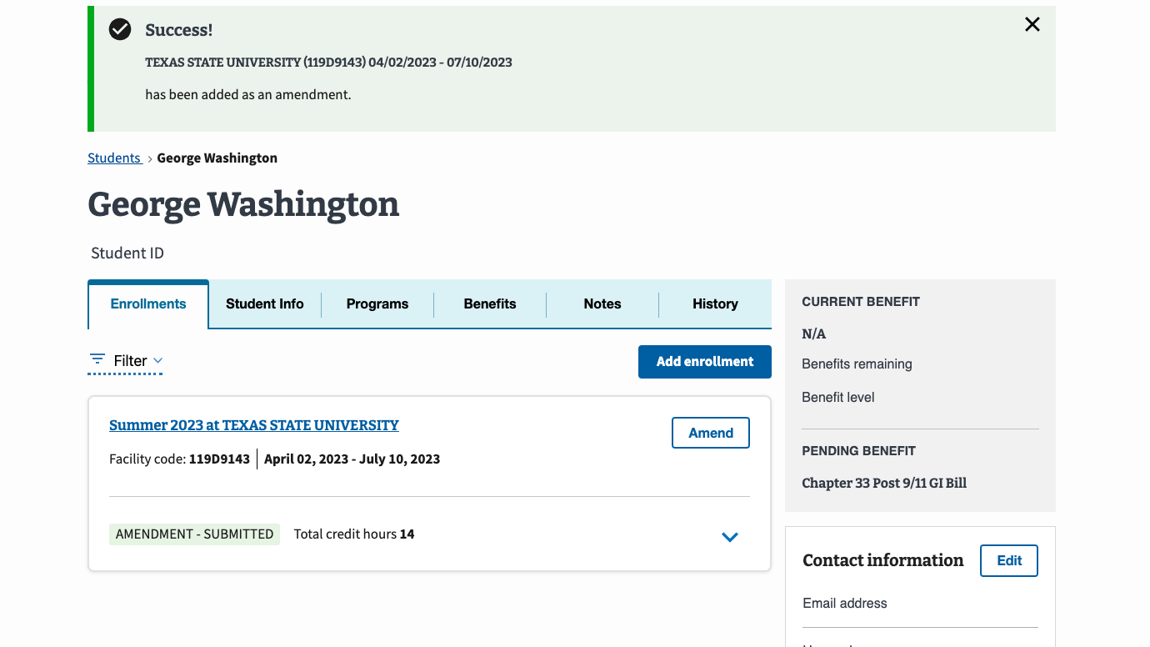
IHL: EM View of Amending an Enrollment (continued 3)
A Success banner displays once the amendment has been successfully amended.
Return to Table of Contents
Return to Start of IHL Section

Slide 33
Select here to navigate to the Helpful Resources section.
Congratulations!
This is the end of the instructions for the selected facility type.
Return to Table of Contents
Return to Start of IHL Section

Slide 34
Non-College degree program (NCD)
Access the appropriate form and its relevant crosswalk to EM by selecting the hyperlinked section below or navigating to the corresponding page number.
VA Form 22-1999 Side A – VA Enrollment Certification – Navigate to page 36
Create a Student – Navigate to page 39
Submit an Enrollment – Navigate to page 45
VA Form 22-1999b – Notice of Change in Student Status – Navigate to page 52
Return to Table of Contents

Slide 35
NCD VA Form 22-1999 Side A – VA Enrollment Certification
Return to Table of Contents
Return to Start of NCD Section

Slide 36
NCD: VA Form 22-1999 Side A to EM Overview
In EM, you need to first find or add the student in the system before you can add an enrollment. The following sections aligns VA Form 22-1999 Side A to how these actions are completed in EM.
Submitting Enrollments
Creating a Student
A
B
The process for submitting enrollment certifications in EM. Navigate to page 39 to view the crosswalk for submitting enrollments for NCD institution types in EM.
The process of entering a student’s biographical and program information into EM. SCOs only create a student if the student cannot be found in a search. Navigate to the EM User Guide on the Resources for Schools page to learn how to search for a student.
C
E
D
Student Information
Begin and End Date for Courses
Credit or Clock Hours
Tuition and Fees
Vacation Period
Notes
SCO Certification
Name of Student, Current Address
Social Security Number (SSN) and/or VA File Number
Type of Training
Name of Program
Applicable to both Submitting Enrollments and Creating a Student

Slide 37
NCD: Changes – 1999 Side A Amendments vs 1999b Adjustments
Enrollment Date changes using Paper Form Amendments
Previously, SCOs would use a blank form and write the appropriate information and include new dates (e.g., 5/19/23 changed to 5/10/23).
Then, the SCO submitted a new form with updated dates.
Changes to a Student’s Enrollment Status using Paper Form Adjustments
Previously, the SCOs selected:
“Reason for termination” checkbox in the “Termination” section or
“Type of adjustment” checkbox in the “Adjustment of Credit or Clock Hours” section.
Enrollment Date Amendments changes using EM
Now, if term dates need to be corrected, navigate to the previously submitted enrollment and select the “Amend” button.
On this page, select the calendar icon and select the appropriate dates.
Submit the amendment to finalize this process.
Changes to a Student’s Enrollment Status using an Amendment EM
Now, if a student’s status needs to change, navigate to the previously submitted enrollment and select the “Amend” button.
On the next page, make any needed changes to the editable fields.
Submit the amendment to finalize this process.

Slide 38
NCD VA Form 22-1999 Side A – VA Enrollment Certification Creating a Student
Return to Table of Contents
Return to Start of NCD Section

Slide 39
NCD: VA Form 22-1999 Side A vs EM – Creating a Student
This section outlines how to create a student before submitting an enrollment certification. SCOs only create a student if they are not in the EM system. Navigate to the EM User Guide on the Resources for Schools page to learn how to search for a student.
Begin with the table below to identify the task as it is completed using VA Form 22-1999 Side A and how the task is completed in EM. Each lettered task aligns with the letters in the pages that follow.
# | Task | VA Form 22-1999 Side A | EM-NCD
A | Student Information | SCOs wrote a student’s name and current address on the form. | SCOs type the student’s “First name,” “Middle name,” and “Last name.” EM asks for additional information, including, “Date of Birth,” “Student ID,” “Mobile phone number,” “Home phone number,” and “Email address.” Not all fields are required. SCOs scroll down the page to select the “Address type” dropdown menu to select the type of address.
B | SSN of Student | SCOs wrote the student’s SSN. | SCOs type the student’s SSN.
C | Type of Training | SCOs checked off the type of training. | SCO’s select the dropdown menu to select the type of training.
D | Matriculated Student | SCOs checked off “yes” or “no” to indicate whether a student matriculated at a facility. | SCOs select the dropdown menu to select the type of Objective.
E | Name of Program | SCOs wrote the student’s name of Program. | SCOs select the dropdown menu to select the Program name.
Return to Table of Contents
Return to Start of NCD Section

Slide 40
NCD: VA Form 22-1999 Side A to EM
The following section aligns with VA Form 22-1999 Side A actions for Creating a Student in EM.
A
B
E
Creating a Student
C
D
Please note the following while reviewing this form:
“CTRL” + select the number associated with the field to navigate to the updated functionality in EM.
VA File Numbers (Box 2 on 22-1999) are only used when creating a new Chapter 35 trainee. VA File Numbers can only be viewed when completing the actions to print a certification.
Social Security numbers (SSNs) (Box 4 on 22-1999) are only used when creating a new trainee. SSNs cannot be edited or searched in EM. SSNs can only be viewed when printing the certification.
Yellow Ribbon and % eligibility is shown on the Benefits tab of a Student’s Profile and is inputted by VA. If the student is 100% eligible, the SCO can select Yellow Ribbon Recipient (Box 7b and 12 on 22-1999) when creating an enrollment. Yellow ribbon is only applicable to NCD students at IHL facilities.
Return to Table of Contents
Return to Start of NCD Section

Slide 41
NCD: EM View of Creating a Student
To learn how to navigate to the Student Profile, go to the EM User Guide on the Resources for Schools page. If the student is not in EM, they need to be created.
In EM, there is a field to include the student’s “Benefit type.” Your student provides this information.
A.
Type the student’s “First name,” “Middle name,” and “Last name.”
EM asks for additional information, including “Date of Birth,” “Student ID,” “Mobile phone number,” “Home phone number,” and “Email address.” Not all fields are required.
Scroll down the page to select the “Address type” dropdown menu to select the type of address.
A
B
B.
Type the student’s SSN.
A
Select the “Continue” button to move to the next page.
Return to Table of Contents
Return to Start of NCD Section

Slide 42
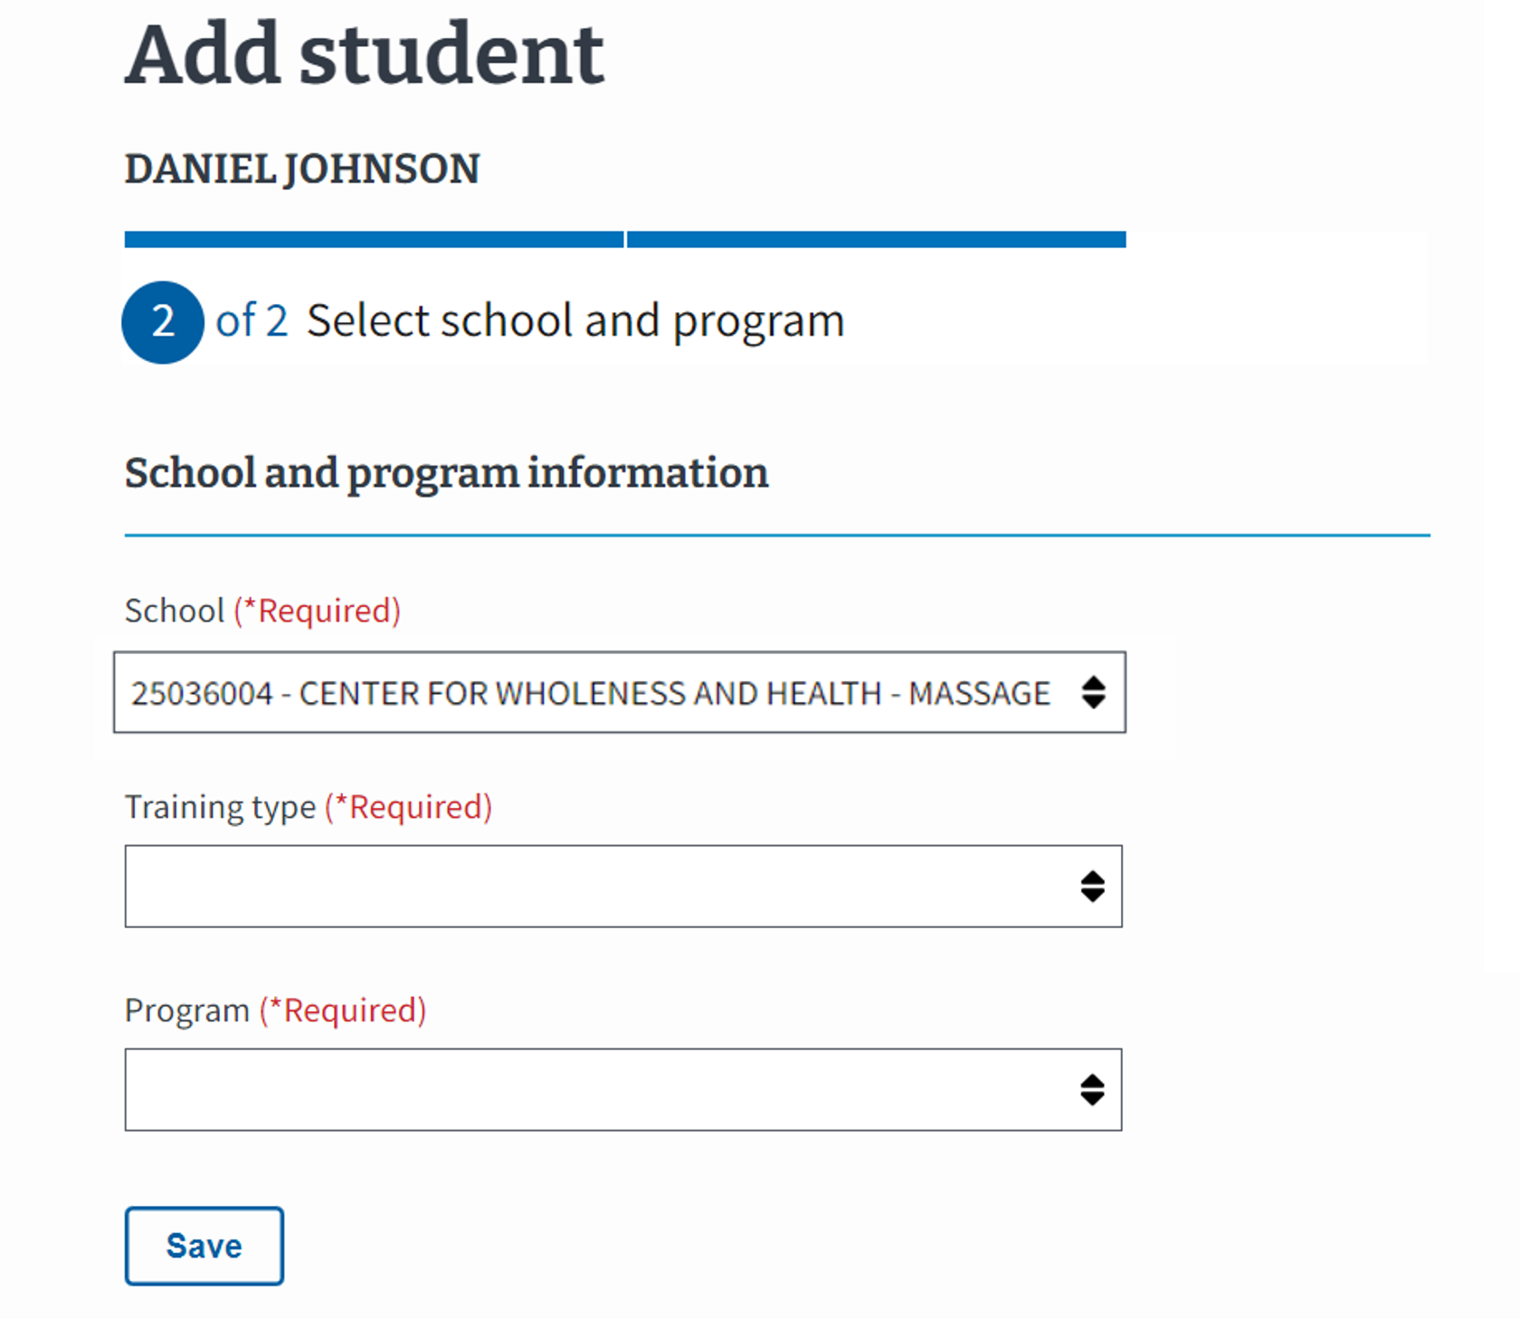
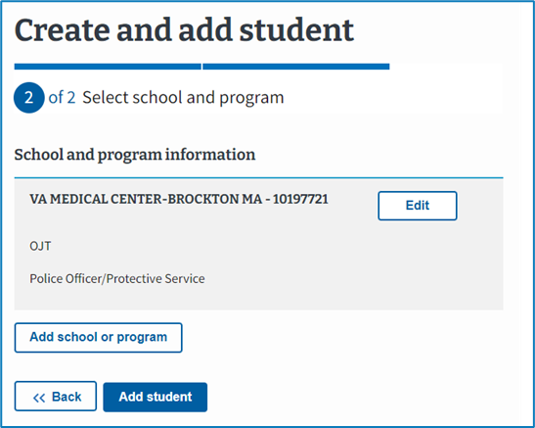
NCD: EM View of Creating a Student (Continued 1)
C.
Select the School the student is enrolled at. The dropdown contains the SCO’s assigned facilities.
D.
Select the dropdown menu to select the type of training.
C
D
E.
Select the dropdown menu to select the Program name.
E
Select “Add student.”
Select “Save.”
Return to Table of Contents
Return to Start of NCD Section

Slide 43
NCD: EM View of Creating a Student (continued 2)
The student’s information is now available in EM. From here, you will be able to add an enrollment.
Return to Table of Contents
Return to Start of NCD Section

Slide 44
NCD VA Form 22-1999 Side A – VA Enrollment Certification Submitting an Enrollment
Return to Table of Contents
Return to Start of NCD Section

Slide 45
NCD: VA Form 22-1999 Side A vs EM – Submitting an Enrollment
This section outlines how to submit an enrollment certification. Begin with the table below to identify the task as it is completed using VA Form 22-1999 Side A and how the task is completed in EM. Each numbered task aligns with the numbered items in the pages that follow.
# | Task | VA Form 22-1999 Side A | EM – NCD
1 | Student Information | SCOs wrote a student’s name and current address on the form. | Located at the top of the screen, EM displays the student’s name after the student is created and/or searched and the user navigates to that profile. The student’s address is located on the right-hand bottom side of the screen.
2 | Begin and End Date for Courses | SCOs wrote the begin and end date for the courses a student was completing. | SCOs select the calendar icon to select the appropriate begin and end dates for student courses. SCOs may use preset enrollment dates to automatically fill in the begin and end dates.
3 | Credit or Clock Hours | SCOs wrote the number of credit or clock hours for each type of course taken. | SCOs type the numerical values for the number of credit or clock hours for each type of course.
4 | Tuition and Fees | SCOs wrote the tuition and fees when required. | SCOs type the tuition and fees in EM when required.
5 | Vacation Period | SCOs wrote the vacation period data. | SCOs select the “Vacation period” button and populate the necessary data. Preset vacation dates can be selected in EM.
6 | Remarks | SCOs wrote remarks concerning a student. | SCOs add a VBA remark if needed. The selection of some VBA remarks require providing additional information. SCOs should use the "Notes" section to capture student and school specific information. Notes are not sent to VA with the enrollment but can be reviewed by VA, if necessary.
7 | SCO Certification | SCOs completed the form by certifying it by writing the appropriate information. | SCOs select the “Submit enrollment” button to transmit the enrollment to VA or select the “Save as draft” button.
Return to Table of Contents
Return to Start of NCD Section

Slide 46
VA Form 22-1999 Side A to EM
The following section aligns with VA Form 22-1999 Side A actions for Submitting an Enrollment in EM.
Submitting Enrollments
Please note the following while reviewing this form:
“CTRL” + select the number associated with the field to navigate to the updated functionality in EM.
VA File Numbers (Box 2 on 22-1999) are only used when creating a new Chapter 35 trainee. VA File Numbers can only be viewed when completing the actions to print a certification.
Social Security numbers (SSNs) (Box 4 on 22-1999) are only used when creating a new trainee. SSNs cannot be edited or searched in EM. SSNs can only be viewed when printing the certification.
Yellow Ribbon and % eligibility is shown on the Benefits tab of a Student’s Profile and is inputted by VA. If the student is 100% eligible, the SCO can select Yellow Ribbon Recipient (Box 7b and 12 on 22-1999) when creating an enrollment. Yellow ribbon is only applicable to NCD students at IHL facilities.
Return to Table of Contents
Return to Start of NCD Section

Slide 47
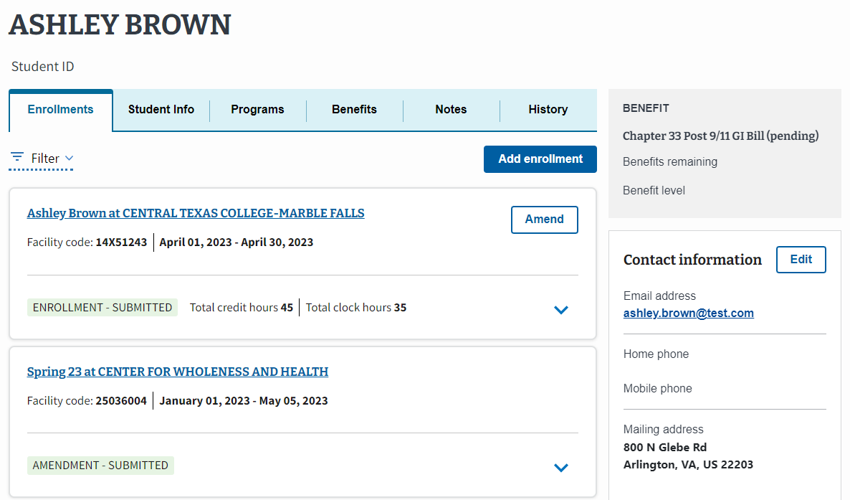
NCD: EM View of Adding an Enrollment
To learn how to navigate to the Student Profile, go to the EM User Guide on the Resources for Schools page.
To create an enrollment for a student, select the “Add enrollment” button.
1.
Located at the top of the screen, EM displays the student’s name once the student is created and/or found in EM and you navigate to that Student’s profile.
The student’s address is located on the right-hand bottom side of the screen.
Note: SCOs can add multiple enrollments at once by selecting the "Add multiple enrollment" button or add one enrollment by selecting "Add one enrollment" button.
Return to Table of Contents
Return to Start of NCD Section

Slide 48
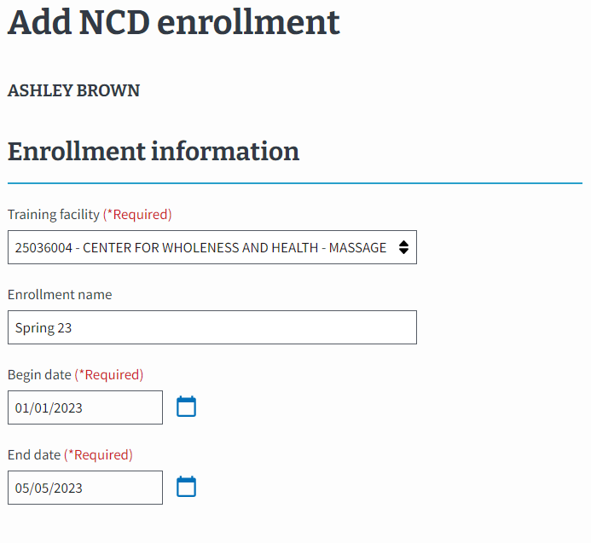
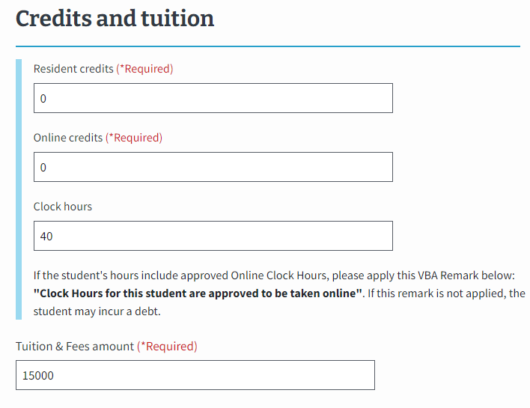
NCD: EM View of Adding an Enrollment (continued 1)
2.
Select the calendar icon to select the appropriate begin and end dates for student courses. SCOs may use preset enrollment dates to automatically fill in the begin and end dates.
3.
Type the numerical values for the type of credit or clock hours.
4.
Type the tuition and fees in EM when required.
Return to Table of Contents
Return to Start of NCD Section

Slide 49
NCD: EM View of Adding an Enrollment (continued 2)
Select the “Vacation period” button and populate the necessary data. Preset vacation dates can be selected in EM.
6.
Add a VBA remark if needed. The selection of some VBA remarks require providing additional information.
Use the "Notes" section to capture student and school specific information. Notes are not sent to VA with the enrollment but can be reviewed by VA, if necessary.
7.
Select the “Submit enrollment” button to transmit the enrollment to VA or select the “Save as draft” button.
Return to Table of Contents
Return to Start of NCD Section

Slide 50
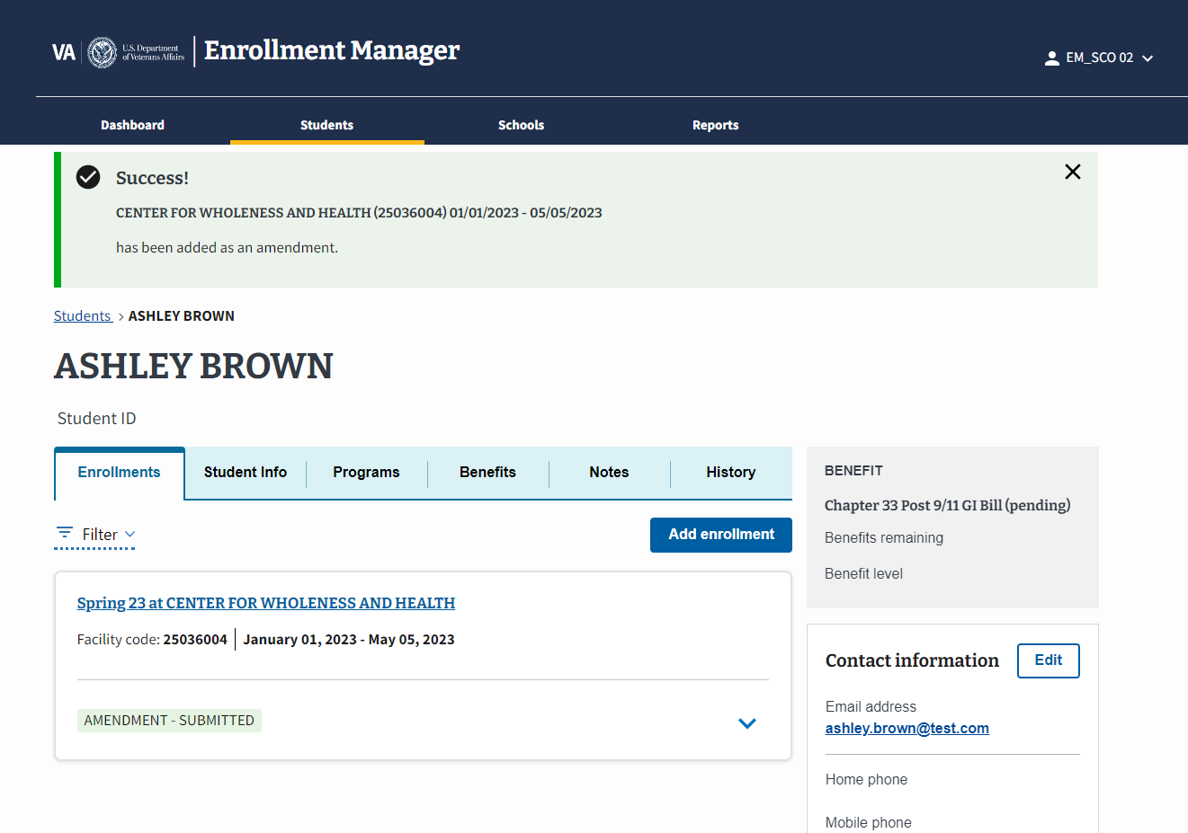
NCD: EM View of Adding an Enrollment (continued 3)
A Success banner displays once the enrollment has been successfully submitted.
Return to Table of Contents
Return to Start of NCD Section

Slide 51
NCD VA Form 22-1999b – Notice of Change in Student Status
Return to Table of Contents
Return to Start of NCD Section

Slide 52
NCD: VA Form 22-1999b vs EM Functionality
This section outlines how to amend an enrollment. Begin with the table below to identify the task as it is completed using VA Form 22-1999b and how the task is completed in EM. Each numbered task aligns with the numbered items in the pages that follow.
# | Task | VA Form 22-1999b | EM – NCD
1 | Student Information | SCOs wrote a student’s name and current address on the form. | Located at the top of the screen, EM automatically populates the student’s name after a student is created. The student’s address is located on the right-hand bottom side of the screen.
2 | Termination Information/ Amendment Reason | Termination: SCOs wrote a student’s termination information and selected the adjustment reason checkbox and enters the last date of attendance in the Termination section. Other sections require completion. Adjustment: SCOs selected the appropriate reason checkbox and provides an effective date in the Adjustment section. Other sections require completion. | SCO selects the “Amend” button on the enrollment. Termination: SCOs select the “Termination” box on the Amend enrollment page. Graduation: SCOs select the “Graduation/End of Term of Course” box on the Amend enrollment page. Amend: SCOs make the appropriate updates to otherwise amend an enrollment. These changes trigger new fields to appear. SCOs select the appropriate “Amendment Reason” from the dropdown. Depending on the selected reason, the SCO may need to provide more information (e.g., Amendment effective date).
3 | Credit or Clock Hours Adjustment | SCOs wrote the updated numerical values in the credit or clock hours section. | SCOs increase or decrease the numerical values in the “Credits and tuition section” in EM.
4 | Remarks | SCOs wrote remarks concerning a student. | SCOs add a VBA remark if needed. The selection of some VBA remarks require providing additional information. SCOs should use the "Notes" section to capture student and school specific information. Notes are not sent to VA with the enrollment but can be reviewed by VA, if necessary.
5 | SCO Certification | SCOs certified enrollment by signing and then submitting the completed form to VA. | SCOs select the “Submit amendment” button to transmit the amendment to VA or select the “Save as draft” button.
Return to Table of Contents
Return to Start of NCD Section

Slide 53
NCD: VA Form 22-1999b
This image represents the fields completed by SCOs when submitting paper adjustments (any change in student status) for Non-College Degree programs.
Please note the following while reviewing this form:
“CTRL” + select the number associated with the field to navigate to the updated functionality in EM.
VA File Numbers (Box 2 on 22-1999b) are only used when creating a new Chapter 35 trainee. VA File Numbers can only be viewed when completing the actions to print a certification.
Social Security numbers (SSNs) (Box 4 on 22-1999b) are only used when creating a new trainee. SSNs cannot be edited or searched in EM. SSNs can only be viewed when printing the certification.
If an SCO is ending an enrollment for a student that has subsequent future enrollments (Box 9 on 22-1999b), an automatic prompt is triggered in EM asking if these enrollments should also end.
Return to Table of Contents
Return to Start of NCD Section

Slide 54
NCD: EM View of Amending an Enrollment
To learn how to navigate to the Student Profile, go to the EM User Guide on the Resources for Schools page.
To amend an enrollment for a student, select the “Amend” button.
1.
Located at the top of the screen, EM displays the student’s name once the student is created and/or found in EM and you navigate to that Student’s profile.
The student’s address is located on the right-hand bottom side of the screen.
Return to Table of Contents
Return to Start of NCD Section

Slide 55
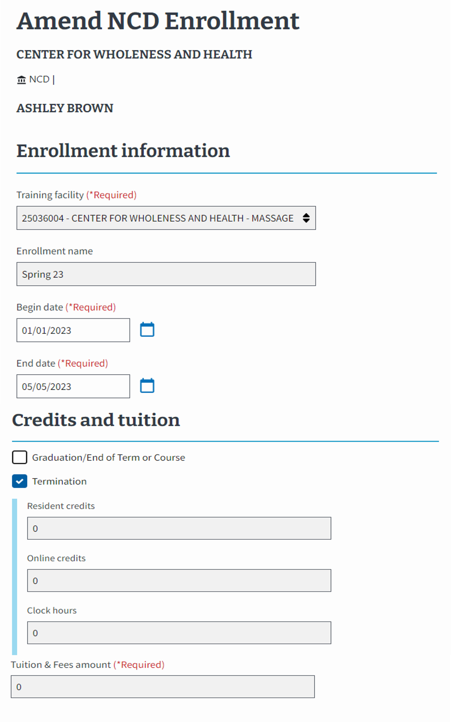
NCD: EM View of Amending an Enrollment (continued 1)
2.
Select the:
“Termination” check box if the student has withdrawn (shown in the example). All values in section 3 will zero out and become non-editable.
“Graduation/End of Term or Course” check box if the student has graduated or completed their program. All values in section 3 become non-editable.
Select neither to amend different components of the enrollment. This keeps the fields in Step 3 editable.
3.
Increase or decrease the numerical values in the “Credits and tuition section” if you are not terminating the enrollment or graduating the student.
Return to Table of Contents
Return to Start of NCD Section

Slide 56
NCD: EM View of Amending an Enrollment (continued 2)
Note: The steps are not out of order. Please continue completing the actions as shown.
The withdrawal or interruption/NCD termination
2. and 3.
Select the “Amendment Reason” dropdown menu to select the appropriate reason for amending. The options available differ based on inputs in step 2 and 3 of the previous slide. Additional fields may appear based on the “Amendment Reason” selection.
Then, enter the Amendment effective date.
4.
Add a VBA remark if needed. The selection of some VBA remarks require providing additional information.
Use the "Notes" section to capture student and school specific information. Notes are not sent to VA with the enrollment but can be reviewed by VA, if necessary.
5.
Select the “Submit amendment” button to transmit the amendment to VA or select the “Save as draft” button.
Return to Table of Contents
Return to Start of NCD Section

Slide 57
NCD: EM View of Amending an Enrollment (continued 3)
A Success banner displays once the amendment has been successfully submitted.
Return to Table of Contents
Return to Start of NCD Section

Slide 58
End of NCD section.
Congratulations!
This is the end of the instructions for the selected facility type.
Select here to navigate to the Helpful Resources section.
Return to Table of Contents
Return to Start of NCD Section

Slide 59
On-the-Job Training & apprenticeship (OJT/App)
Access the appropriate form and its relevant crosswalk to EM by selecting the hyperlinked section below or navigating to the appropriate page number detailed below:
VA Form 22-1999 Side B – VA Enrollment Certification – Navigate to page 61
Create a Student – Navigate to page 63
Submit an Enrollment – Navigate to page 69
VA Form 22-1999b – Notice of Change in Student Status – Navigate to page 76
VA Form 22-6553d-1 – Monthly Certification of On-the-Job and Apprenticeship Training – Navigate to page 83
Return to Table of Contents

Slide 60
OJT/APP VA Form 22-1999 Side B – VA Enrollment Certification
Return to Table of Contents
Return to Start of OJT/APP

Slide 61
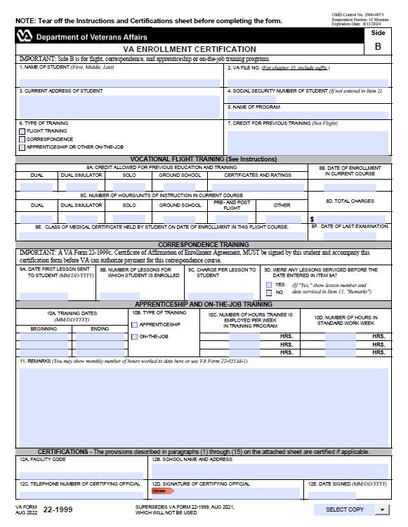
OJT/APP: VA Form 22-1999 Side B to EM Overview
In EM, you need to first find or add the student in the system before you can add an enrollment. The following sections aligns VA Form 22-1999 Side B to how these actions are completed in EM.
Submitting Enrollments
Creating a Student
A
B
The process for submitting enrollment certifications in EM. Navigate to page 68 to view the crosswalk for submitting enrollments for OJT/APP institution types in EM.
The process of entering a trainee’s biographical and program information into EM. Certifying Officials should only create a student if the student cannot be found in a search. Navigate to the EM User Guide on the Resources for Schools page to learn how to search for a student.
D
C
Student Information
Student Information
Begin and End Date for the Training Program
Trainee’s Work Hours per Week
Standard Working Hours per Week
Hours Credited for Previous Training
Remarks
Certifying Official Certification
Name of Student, Current Address
Social Security Number (SSN) and/or VA File Number
Type of Training
Name of Program
Applicable to both Submitting Enrollments and Creating a Student

Slide 62
OJT/APP VA Form 22-1999 Side B – VA Enrollment Certification Creating a Student
Return to Table of Contents
Return to Start of OJT/APP

Slide 63
OJT/APP: VA Form 22-1999 Side B – Creating a Student
This section outlines how to create a trainee. Certifying Officials should only create a trainee if they are not in the EM system. Navigate to the EM User Guide on the Resources for Schools page to learn how to search for a student.
Begin with the table below to identify the task as it is completed using VA Form 22-1999 Side B and how the task is completed in EM. Each numbered task aligns with the numbered items in the pages that follow.
# | Task | Form 22-1999 Side B | EM-OJT/APP
A | Trainee Information | Certifying Officials wrote a trainee’s name and current address on the form. | Certifying Officials type the trainee’s first, middle and last name. Then, scroll down the page to select the “Address type” dropdown menu to select the type of address.
B | SSN of Trainee | Certifying Officials wrote the trainee’s SSN. | Certifying Officials type the trainee’s SSN.
C | Type of Training | Certifying Officials checked off the type of training. | Certifying Officials select the dropdown menu to select the type of training. Note: There is one training type for each program type, APP for Apprenticeship and OJT for On-the-Job Training.
D | Name of Program | Certifying Officials wrote the trainee’s name of Program. | Certifying Officials select the dropdown menu to select the Program name.
Return to Table of Contents
Return to Start of OJT/APP

Slide 64
OJT/APP: VA Form 22-1999 Side B
The following section aligns with VA Form 22-1999 Side B actions for Creating a Student in EM.
A
B
D
Creating a Student
C
Please note the following while reviewing this form:
“CTRL” + select the number associated with the field to navigate to the updated functionality in EM.
VA File Numbers (Box 2 on 22-1999) are only used when creating a new Chapter 35 trainee. VA File Numbers can only be viewed when completing the actions to print a certification.
Social Security numbers (SSNs) (Box 4 on 22-1999) are only used when creating a new trainee. SSNs cannot be edited or searched in EM. SSNs can only be viewed when printing the certification.
Return to Table of Contents
Return to Start of OJT/APP

Slide 65
OJT/APP: EM View of Creating a Student
To learn how to navigate to the trainee’s profile, go to the EM User Guide on the Resources for Schools page. If the trainee is not in EM, they need to be created.
A.
Type the trainee’s “First name,” “Middle name,” and “Last name.”
EM asks for additional information, including “Date of Birth,” “Student ID,” “Mobile phone number,” “Home phone number,” and “Email address.” Not all fields are required.
Scroll down the page to select the “Address type” dropdown menu to select the type of address.
In EM, there is a field to include the trainee’s “Benefit type”. The trainee provides this information.
A
B
B.
Type the trainee’s SSN.
A
Select the “Continue” button to move to the next page.
Return to Table of Contents
Return to Start of OJT/APP

Slide 66
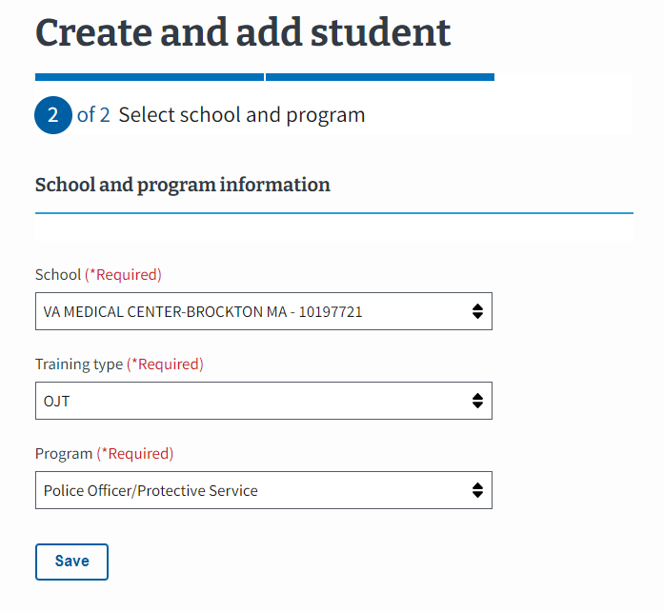
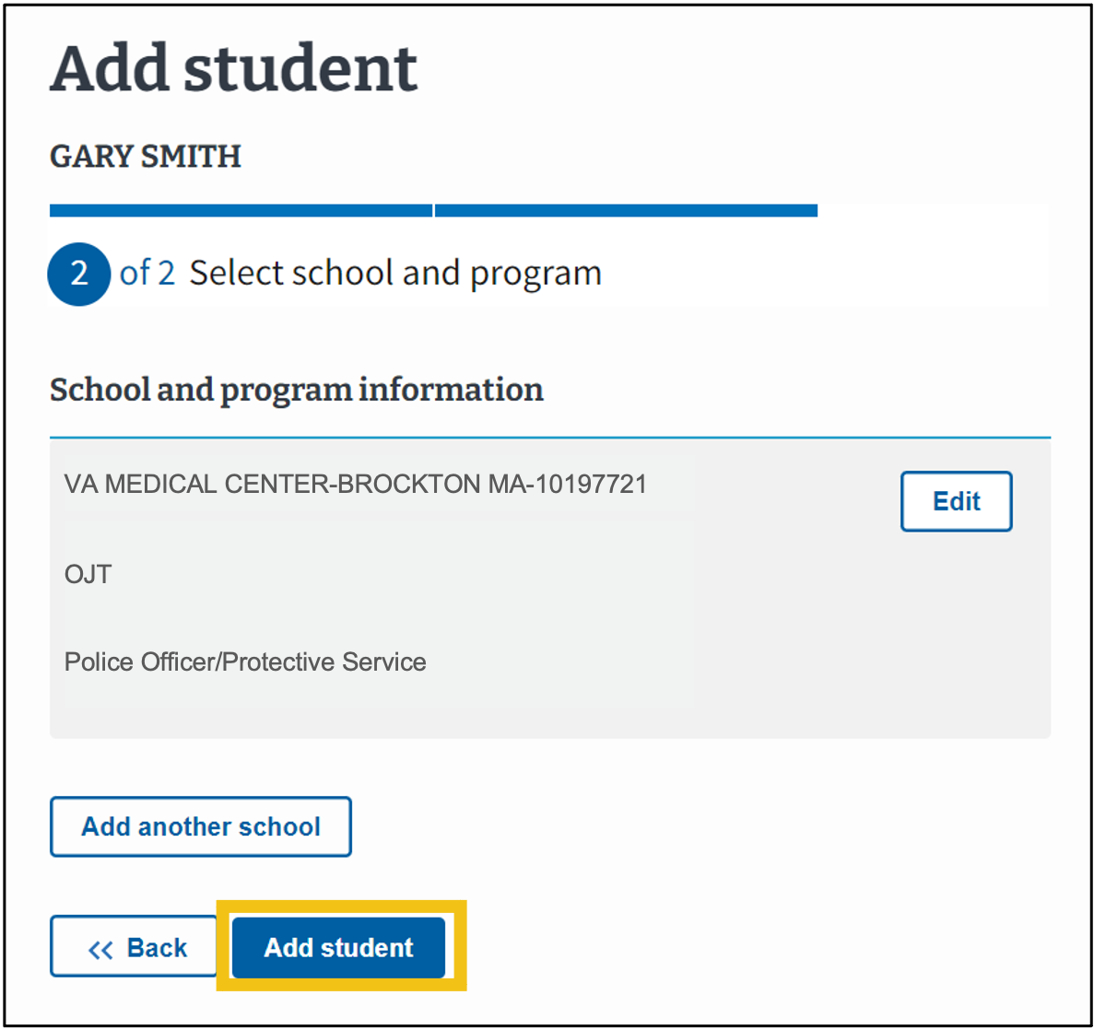
OJT/APP: EM View of Creating a Student (continued 1)
Select the facility the trainee is working at. The dropdown contains the Certifying Official’s assigned facilities.
C.
Select the “Training type” from the dropdown menu.
Note: There is one training type for each training program, APP for Apprenticeship and OJT for On-the-Job Training.
C
D
D.
Certifying Official selects the “Program” from the dropdown menu.
Select “Save.”
Select “Add student.”
Return to Table of Contents
Return to Start of OJT/APP

Slide 67
OJT/APP: EM View of Creating a Student (continued 2)
The trainee’s information is now available in EM. From here, you will be able to add an enrollment.
Return to Table of Contents
Return to Start of OJT/APP

Slide 68
OJT/APP
VA Form 22-1999 Side B –
VA Enrollment Certification
Submitting an Enrollment
Return to Table of Contents
Return to Start of OJT/APP

Slide 69
OJT/APP: VA Form 22-1999 Side B vs EM Functionality
This section outlines how to submit an enrollment certification. Begin with the table below to identify the task as it is completed using VA Form 22-1999 Side B and how the task is completed in EM. Each numbered task aligns with the numbered items in the pages that follow. Note: Regardless of training type, you must submit an enrollment before you can add monthly hours.
# | Task | VA Form 22-1999 Side B | EM – OJT/APP
1 | Student Information | Certifying Officials wrote a trainee's name and current address on the form. | Located at the top of the screen, EM displays the trainee’s name after a trainee is created and/or searched and the user navigates to that profile. The trainee's address is located on the right-hand bottom side of the screen.
2 | Begin and End Date for the Training Program | Certifying Officials wrote the begin and end date for trainee's training program. | Certifying Officials select the calendar icon to select the appropriate begin and end dates for trainee’s programs.
3 | Trainee’s Work Hours per Week | Certifying Officials wrote the number of hours in training program per week. | Certifying Officials type the number of hours in training program per week.
4 | Standard Working Hours per Week | Certifying Officials wrote the standard work hours per week. | Certifying Officials type the standard work hours per week.
5 | Hours Credited for Previous Training | Certifying Officials provided credit to trainee by writing in the number of hours of previous training applied to their current training program. | Certifying Officials select the dropdown menu to select whether the trainee had prior training time. If so, then more fields will populate.
6 | Remarks | Certifying Officials wrote remarks concerning a trainee. | Certifying Officials can choose to add a VBA remark or Custom Remark if needed. Certifying Officials should use the "Notes" section to capture trainee and school specific information. Notes are not sent to VA with the enrollment but can be reviewed by VA, if necessary.
7 | SCO Certification | Certifying Officials certified enrollment by signing and then submitting the completed form to VA. | Certifying Officials select the “Submit enrollment” button to submit the enrollment or select the “Save as draft” button.
Return to Table of Contents
Return to Start of OJT/APP

Slide 70
OJT/APP: VA Form 22-1999 Side B to EM Submitting an Enrollment
OJT/APP: VA Form 22-1999 Side B to EM
The following section aligns with VA Form 22-1999 Side B actions for Submitting an Enrollment in EM.
Submitting Enrollments
Please note the following while reviewing this form:
“CTRL” + select the number associated with the field to navigate to the updated functionality in EM.
VA File Numbers (Box 2 on 22-1999) are only used when creating a new Chapter 35 trainee. VA File Numbers can only be viewed when completing the actions to print a certification.
Social Security numbers (SSNs) (Box 4 on 22-1999) are only used when creating a new trainee. SSNs cannot be edited or searched in EM. SSNs can only be viewed when printing the certification.
Return to Table of Contents
Return to Start of OJT/APP

Slide 71
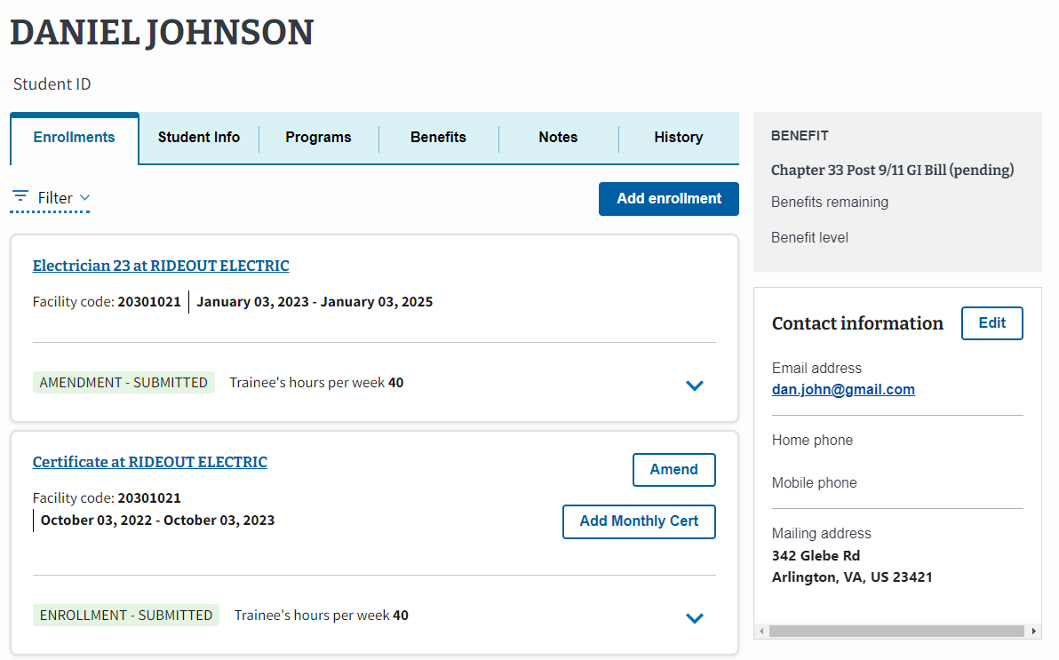
OJT/APP: EM View of Submitting an Enrollment
To learn how to navigate to the Student Profile, go to the EM User Guide on the Resources for Schools page.
To create an enrollment for a student, select the “Add enrollment” button.
1.
Located at the top of the screen, EM displays the trainee’s name once the trainee is created and/or found in EM and you navigate to the Trainee’s profile.
The trainee's address is located on the right-hand bottom side of the screen.
Return to Table of Contents
Return to Start of OJT/APP

Slide 72
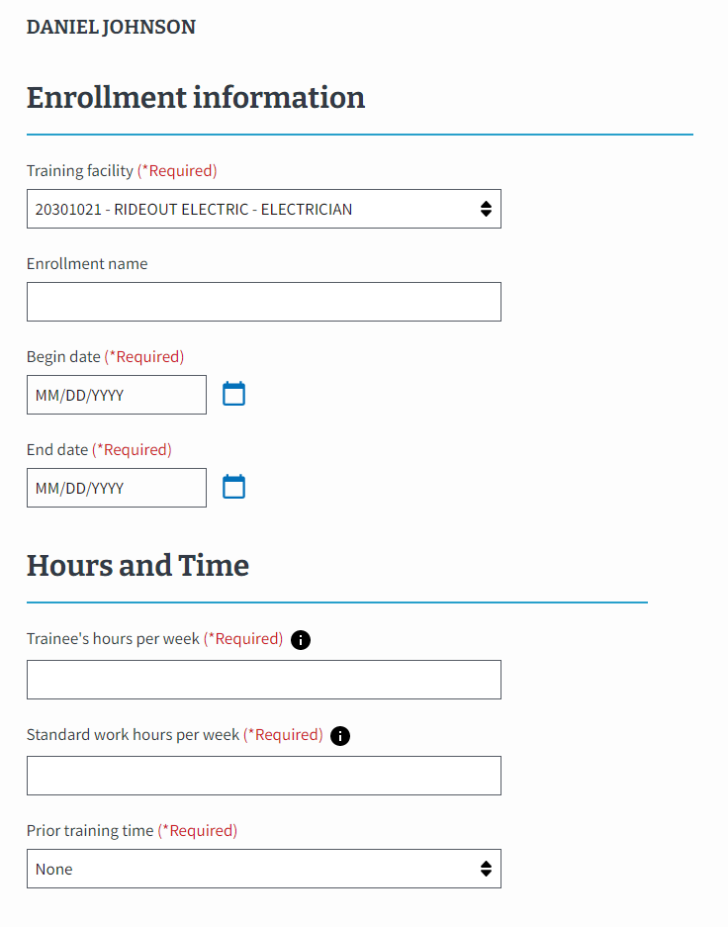
OJT/APP: EM View of Submitting an Enrollment
2.
Select the calendar icon to select the appropriate begin and end dates for trainee’s program.
3.
Type the number of hours in training program per week.
4.
Type the standard work hours per week.
5.
Select the dropdown menu to select whether prior training time is being submitted or not applicable.
Return to Table of Contents
Return to Start of OJT/APP

Slide 73
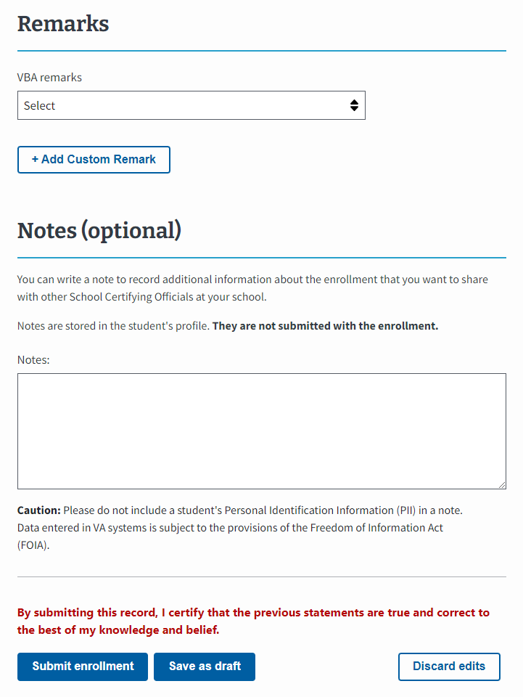
OJT/APP: EM View of Submitting an Enrollment
6.
Add a VBA remark or Custom Remark if needed.
Use the "Notes" section to capture trainee and school specific information. Notes are not sent to VA with the enrollment but can be reviewed by VA, if necessary.
7.
Select the “Submit enrollment” button to transmit the enrollment to VA or select the “Save as draft” button.
Note: navigate to the EM User Guide on the Resources for Schools page to learn how to amend an enrollment. Enrollments should only be amended before the first monthly certification is submitted.
Return to Table of Contents
Return to Start of OJT/APP

Slide 74
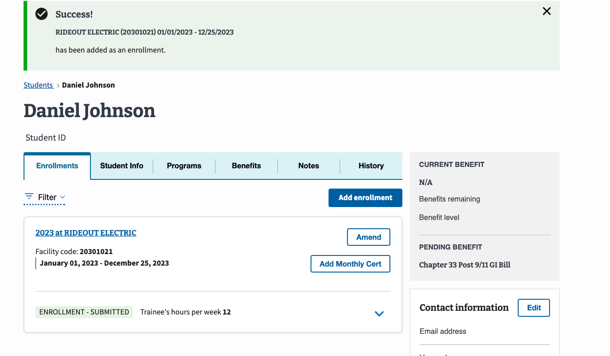
OJT/APP: EM View of Submitting an Enrollment slide 2
OJT/APP: EM View of Submitting an Enrollment
A Success banner displays once the enrollment has been successfully submitted.
Return to Table of Contents
Return to Start of OJT/APP

Slide 75
OJT/APP
VA Form 22-6553d-1
Monthly Certification of On-the-Job and Apprenticeship Training
Return to Table of Contents
Return to Start of OJT/APP

Slide 76
OJT/APP: VA Form 22-6553d-1 vs EM Functionality
This section outlines how to submit a Monthly Certification. Begin with the table below to identify the task as it is completed using VA Form 22-6553d-1 and how the task is completed in EM. Each numbered task aligns with the numbered items in the pages that follow. Note: SCOs cannot submit monthly hours until an enrollment is submitted equivalent to originally submitted paper Side B VA Form 22-1999. Monthly certifications submitted on paper must be resubmitted as Monthly Certs in EM.
# | Task | VA Form 22-6553d-1 | EM – OJT/APP
1 | Trainee Information | Certifying Officials wrote a trainee’s name and current address on the form. | Located at the top of the screen, EM displays the trainee’s name after a trainee is created and/or searched and the user navigates to that profile. The trainee’s address is located on the right-hand bottom side of the screen.
2 | Months/Years to be Certified | Certifying Officials wrote the trainee’s certification months/years. | Certifying Officials view the prepopulated begin and end dates and the certification begin and end dates.
3 | Number of Hours Trained | Certifying Officials wrote the hours worked in a training program. | Certifying Officials type the trainee’s hours worked into the hours trained section.
4 | Wage Rate | Certifying Officials checked a “Yes” or “No” box whether the trainee wage rate was in accordance with the training agreement. | Certifying Officials select “Yes” or “No” to indicate whether the trainee’s wage rate was in accordance with the training agreement.
5 | Enrollment in the Declared Month(s) | Certifying Officials checked a “Yes” or “No” box whether the trainee was enrolled in and pursuing training in the allocated months listed. | Certifying Officials select “Yes” or “No” to indicate whether the trainee was enrolled in and pursuing training during the allocated month.
6 | Remarks | Certifying Officials wrote remarks concerning the trainee. | Certifying Officials choose to add a VBA remark or Custom Remark if needed. Certifying Officials should use the "Notes" section to capture trainee and facility specific information. Notes are not sent to VA with the enrollment but can be reviewed by VA, if necessary.
7 | SCO Certification | Certifying Official certified enrollment by signing and then submitting the completed form to VA. | Certifying Officials select the “Submit certification” button to submit the enrollment or select the “Save as draft” button.
Return to Table of Contents
Return to Start of OJT/APP

Slide 77
OJT/APP: VA Form 22-6553d-1
This image represents the fields completed by Certifying Officials when submitting monthly certifications for OJT/APP programs.
Please note the following while reviewing this form:
“CTRL” + select the number associated with the field to navigate to the updated functionality in EM.
VA File Numbers/Social Security numbers (SSNs) are only used when creating a new trainee. SSNs cannot be edited or searched in EM. SSNs can only be viewed when printing the certification.
Payee Number is not used in EM.
Return to Table of Contents
Return to Start of OJT/APP

Slide 78
OJT/APP: EM View of Adding a Monthly Certification
To learn how to navigate to the Student Profile, go to the EM User Guide on the Resources for Schools page.
To add a monthly certification for a student, select the “Add Monthly Cert” button.
1.
Located at the top of the screen, EM displays the trainee’s name once the trainee is created and/or found in EM and you navigate to that Trainee’s profile.
The trainee’s address is located on the right-hand bottom side of the screen.
Return to Table of Contents
Return to Start of OJT/APP

Slide 79
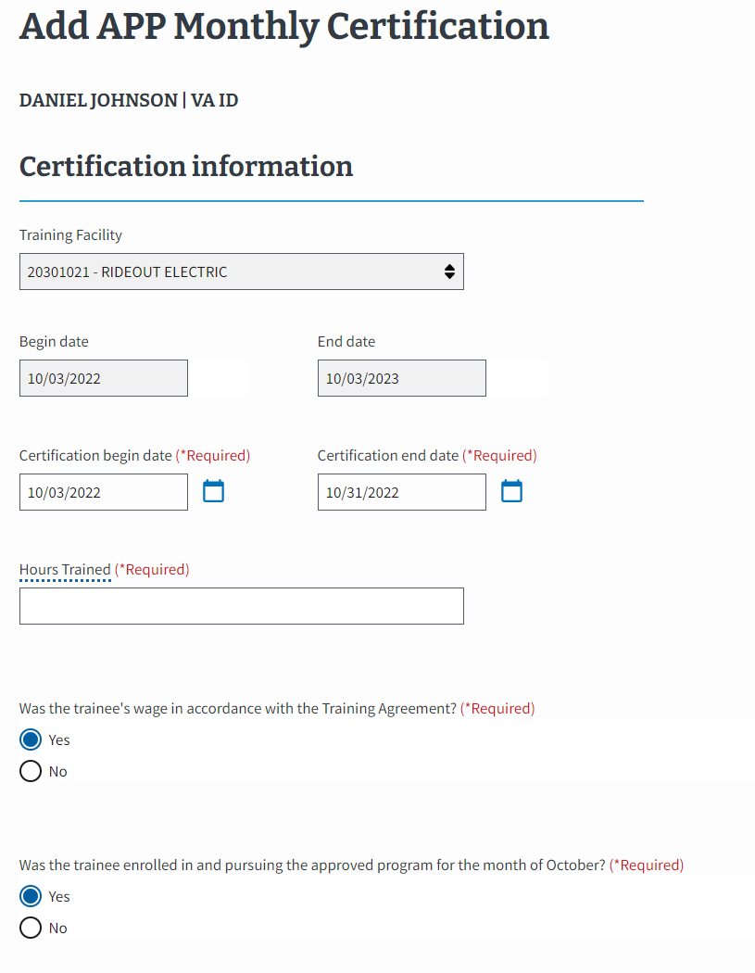
OJT/APP: EM View of Adding a Monthly Certification (continued 1)
2.
View the prepopulated program begin and end dates and the monthly certification begin and end dates.
3.
Type the trainee’s hours worked into the “Hours Trained” section.
4.
Select “Yes” or “No” to indicate whether the trainee’s wage rate was in accordance with the training agreement.
5.
Select “Yes” or “No” to indicate whether the trainee was enrolled in and pursuing training during the allocated month.
Return to Table of Contents
Return to Start of OJT/APP

Slide 80
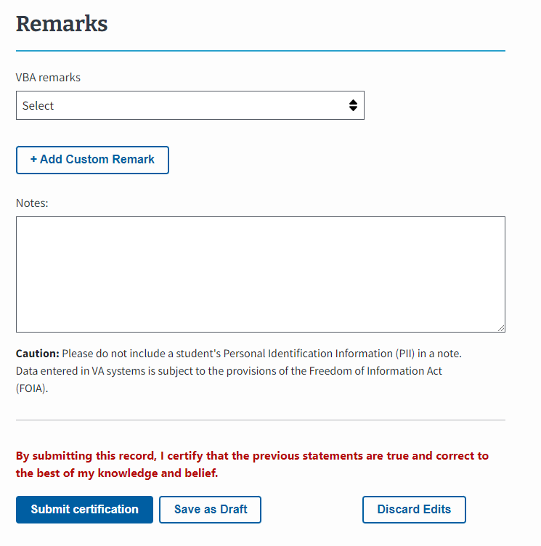
OJT/APP: EM View of Adding a Monthly Certification (continued 2)
6.
Add a VBA remark or Custom Remark if needed.
Note: to make a correction to the hours submitted on a monthly certification, Certifying Officials must add a remark to the next monthly certification.
Use the "Notes" section to capture student and school specific information. Notes are not sent to VA with the enrollment but can be reviewed by VA, if necessary.
7.
Select the “Submit certification” button to submit the enrollment or select the “Save as draft” button.
Note: navigate to the EM User Guide on the Resources for Schools page for more information on how to correct a submitted monthly certification.
Return to Table of Contents
Return to Start of OJT/APP

Slide 81
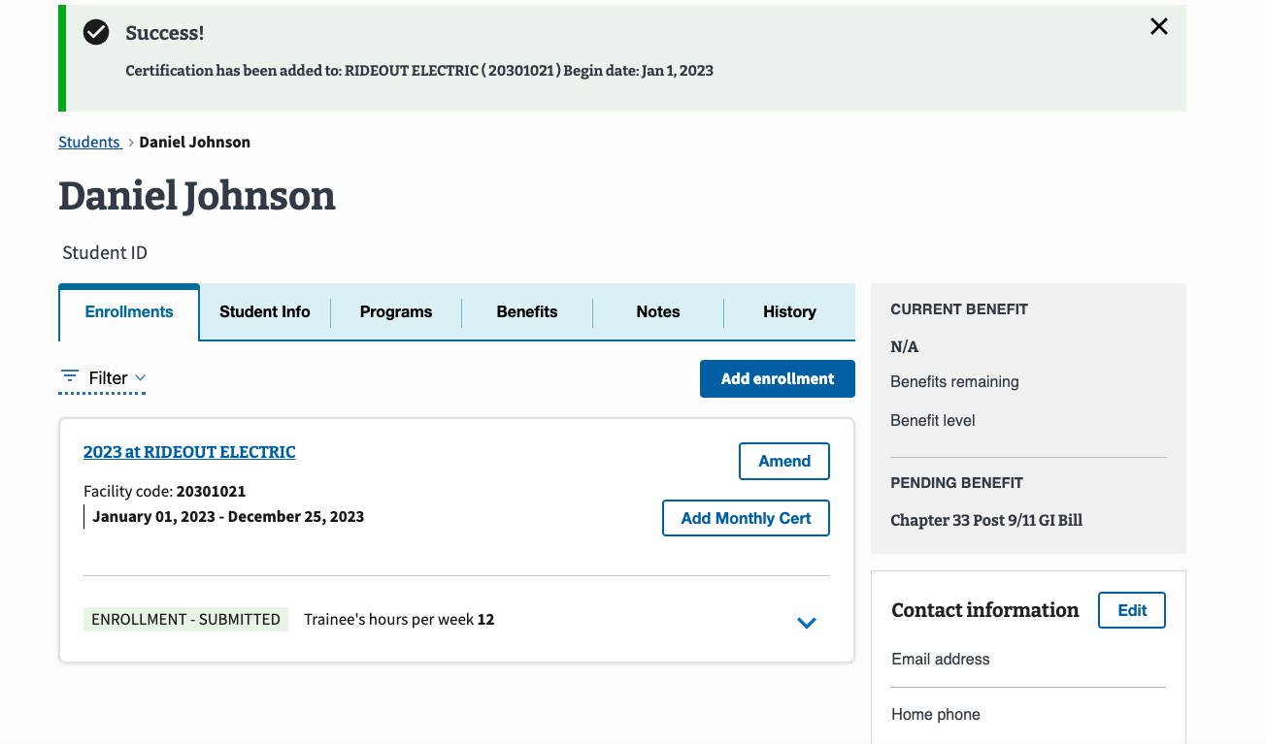
OJT/APP: EM View Adding a Monthly Certification (continued 3)
A Success banner displays once the certification has been successfully submitted.
Return to Table of Contents
Return to Start of OJT/APP

Slide 82
OJT/APP
VA Form 22-1999b –
Notice of Change in Student Status
Return to Table of Contents
Return to Start of OJT/APP

Slide 83
OJT/APP: VA Form 22-1999b vs EM Functionality
This section outlines how to terminate a trainee’s certification. It is important to note, in EM an enrollment can only be terminated on a monthly certification. Begin with the table below to identify the task as it is completed using VA Form 22-1999b and how the tasks are completed in EM. Each numbered task aligns with the numbered items in the pages that follow. Navigate to the EM User Guide on the Resources for Schools page to learn how to amend an enrollment or correct a submitted monthly certification, if needed. Enrollment should only be amended before the first monthly certification is submitted.
# | Task | VA Form 22-1999b | EM – OJT/APP
1 | Trainee Information | Certifying Officials wrote a trainee’s name and current address on the form. | Located at the top of the screen, EM displays the trainee’s name after a trainee is created and/or searched and the user navigates to that profile. The trainee’s address is located on the right-hand bottom side of the screen.
2 | Termination Information/Termination Reason | Certifying Officials selected the termination reason check box and provided the last date worked. Other sections require completion. | Certifying officials report a termination on the monthly certification of the last month of training. To do so, they must enter the hours worked and choose “No” to “Was the Trainee enrolled in and pursuing the program for the month.” This prompts the SCO to select the “Date Terminated” and the “Termination Reason”. ​
3 | Remarks | Certifying Officials wrote remarks concerning the trainee. | Certifying Officials choose to add a VBA remark or Custom Remark if needed. Note: If an SCO must make a correction to the hours submitted on a monthly certification, they must add a remark to the next monthly certification. Certifying Officials use the "Notes" section to capture trainee and facility specific information. Notes are not sent to VA with the enrollment but can be reviewed by VA, if necessary.
4 | Certifying Official Certification | Certifying Officials certified enrollment by signing and then submitting the completed form to VA. | Certifying officials select the “Submit certification” button to submit the enrollment or select the “Save as draft” button.
Return to Table of Contents
Return to Start of OJT/APP

Slide 84
OJT/APP: VA Form 22-1999b
This image represents the fields completed by Certifying Officials submitting paper adjustments for OJT/APP programs.
Please note the following while reviewing this form:
“CTRL” + select the number associated with the field to navigate to the updated functionality in EM.
VA File Numbers (Box 2 on 22-1999b) are only used when creating a new Chapter 35 trainee. VA File Numbers can only be viewed when completing the actions to print a certification.
Social Security numbers (SSNs) (Box 4 on 22-1999b) are only used when creating a new trainee. SSNs cannot be edited or searched in EM. SSNs can only be viewed when printing the certification.
Return to Table of Contents
Return to Start of OJT/APP

Slide 85
OJT/APP: EM View of Terminating an Enrollment
To learn how to navigate to the Student Profile, go to the EM User Guide on the Resources for Schools page.
To terminate an enrollment, select the “Add Monthly Cert” button.
1.
Located at the top of the screen, EM displays the trainee’s name once the trainee is created and/or found in EM and you navigate to that Trainee’s profile.
The trainee’s address is located on the right-hand bottom side of the screen.
Return to Table of Contents
Return to Start of OJT/APP

Slide 86
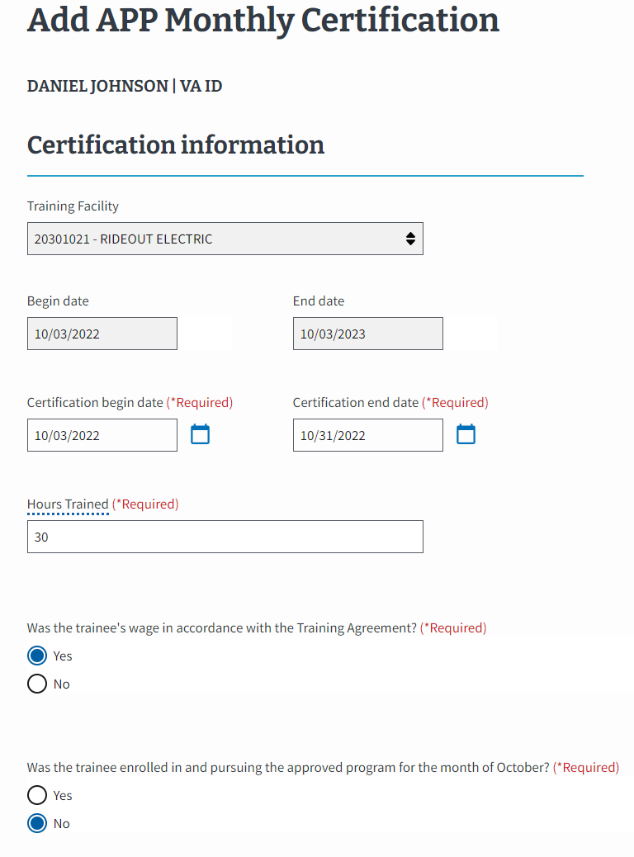
OJT/APP: EM View of Terminating an Enrollment (continued 1)
2.
Enter the hours worked and choose “No” to the question, “Was the Trainee enrolled in and pursuing the program for the month.”
Select the “Date Terminated” and the “Termination Reason.”
Return to Table of Contents
Return to Start of OJT/APP

Slide 87
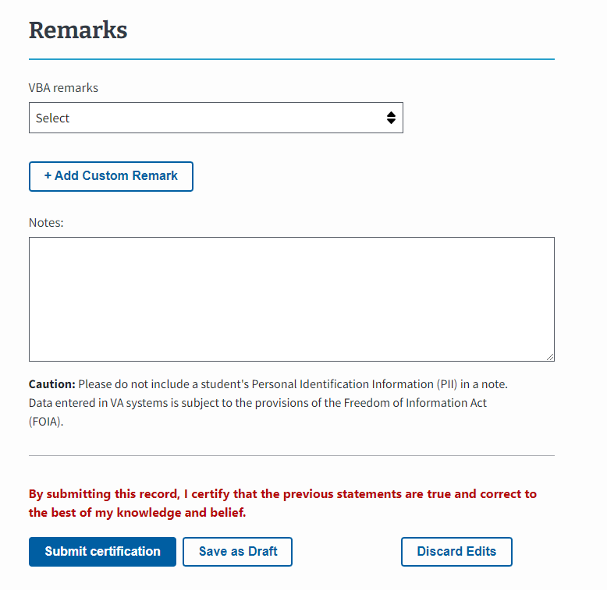
OJT/APP: EM View of Terminating an Enrollment (continued 2)
3.
Add a VBA remark or Custom Remark if needed.
Note: If a Certifying Official needs to make a correction to the hours submitted for a previous month, they must add a remark providing the corrected hours on a subsequent monthly certification.
Use the "Notes" section to capture student and school specific information. Notes are not sent to VA with the enrollment but can be reviewed by VA, if necessary.
4.
Select the “Submit certification” button to submit the enrollment or select the “Save as draft” button.
Return to Table of Contents
Return to Start of OJT/APP

Slide 88
OJT/APP: EM View of Terminating an Enrollment (continued 3)
A Success banner displays once the certification has been successfully submitted.
Return to Table of Contents
Return to Start of OJT/APP

Slide 89
End of OJT/APP section.
Congratulations!
This is the end of the instructions for the selected facility type.
Select here to navigate to the Helpful Resources section
Return to Table of Contents
Return to Start of OJT/APP

Slide 90
FLIGHT
Access the appropriate form and its relevant crosswalk to EM by selecting the hyperlinked section below or navigating to the appropriate page number detailed below:
VA Form 22-1999 Side B – VA Enrollment Certification – Navigate to page 92
Create a Student – Navigate to page 94
Submit an Enrollment – Navigate to page 100
VA Form 22-1999b – Notice of Change in Student Status – Navigate to page 107
VA Form 22-6553c – Monthly Certification of Flight Training – Navigate to page 114
Return to Table of Contents

Slide 91
Flight VA Form 22-1999 Side B – VA Enrollment Certification
Return to Table of Contents
Return to Start of Flight Section

Slide 92
Flight: VA Form 22-1999 Side B to EM Overview
In EM, you need to first find or add the student in the system before you can add an enrollment. The following sections aligns VA Form 22-1999 Side B to how these actions are completed in EM.
Submitting Enrollments
Creating a Student
A
The process for submitting enrollment certifications in EM. Navigate to page 99 to view the crosswalk for submitting enrollments for Flight institution types in EM.
The process of entering a student’s biographical and program information into EM. SCOs only create a student if the student cannot be found in a search. Navigate to the EM User Guide on the Resources for Schools page to learn how to search for a student.
B
D
C
Student Information
Begin Date for Courses/Class of Medical Certificate
Courses Taken and Hours/Credit for Previous Training
Total Charges
Notes
SCO Certification
Name of Student, Current Address
Social Security Number (SSN)
Type of Training
Name of Program
Applicable to both Submitting Enrollments and Creating a Student

Slide 93
FLIGHT VA Form 22-1999 Side B – VA Enrollment Certification Creating a Student
Return to Table of Contents
Return to Start of Flight Section

Slide 94
Flight: VA Form 22-1999 Side B vs EM Functionality
This section outlines how to create a student. SCOs should only create a trainee if they are not in the EM system. Navigate to the EM User Guide on the Resources for Schools page to learn how to search for a student.Begin with the table below to identify the task as it is completed using VA Form 22-1999 Side B and how the task is completed in EM. Each numbered task aligns with the numbered items in the pages that follow.
# | Task | VA Form 22-1999 Side B | EM-FLIGHT
A | Student Information | SCOs wrote a student’s name and current address on the form. | SCOs type the student’s first, middle and last name. Then they scroll down the page to select the “Address type” dropdown menu to select the type of address.
B | SSN of Student | SCOs wrote the student’s SSN. | SCOs type the student’s SSN.
C | Type of Training | SCOs checked off the type of training. | SCOs select the dropdown menu to select “Flight” as the type of training.
D | Name of Program | SCOs wrote the student’s name of Program. | SCOs select the dropdown menu to select the Program name.
Return to Table of Contents
Return to Start of Flight Section

Slide 95
Flight: VA Form 22-1999 Side B to EM
The following section aligns with Form 22-1999 Side B actions for Creating a Student in EM.
A
B
D
Creating a Student
C
Please note the following while reviewing this form:
“CTRL” + select the number associated with the field to navigate to the updated functionality in EM.
VA File Numbers (Box 2 on 22-1999) are only used when creating a new Chapter 35 trainee. VA File Numbers can only be viewed when completing the actions to print a certification.
Social Security numbers (SSNs) (Box 4 on 22-1999) are only used when creating a new student. SSNs cannot be edited or searched in EM. SSNs can only be viewed when printing the certification.
Return to Table of Contents
Return to Start of Flight Section

Slide 96
Flight: EM View of Creating a Student
To learn how to navigate to the Student Profile, go to the EM User Guide on the Resources for Schools page. If the student is not in EM, they need to be created.
In EM, there is a field to include the student’s “Benefit type.” Your student provides you this information.
A.
Type the student’s “First name,” “Middle name,” and “Last name.”
EM asks for additional information, including “Date of Birth,” “Student ID,” “Mobile phone number,” “Home phone number,” and “Email address.” Not all fields are required.
Scroll down the page to select the “Address type” dropdown menu to select the type of address.
A
B
B.
Type the student’s SSN.
Select the “Continue” button to move to the next page.
Return to Table of Contents
Return to Start of Flight Section

Slide 97
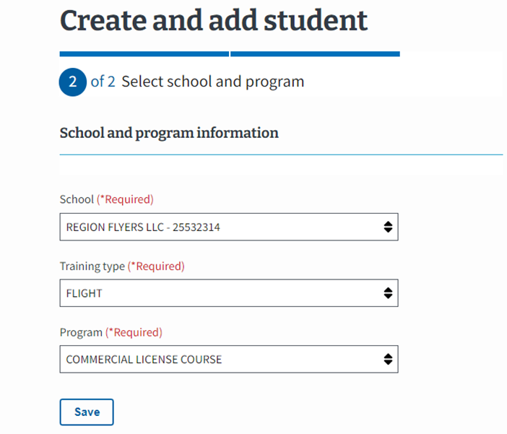
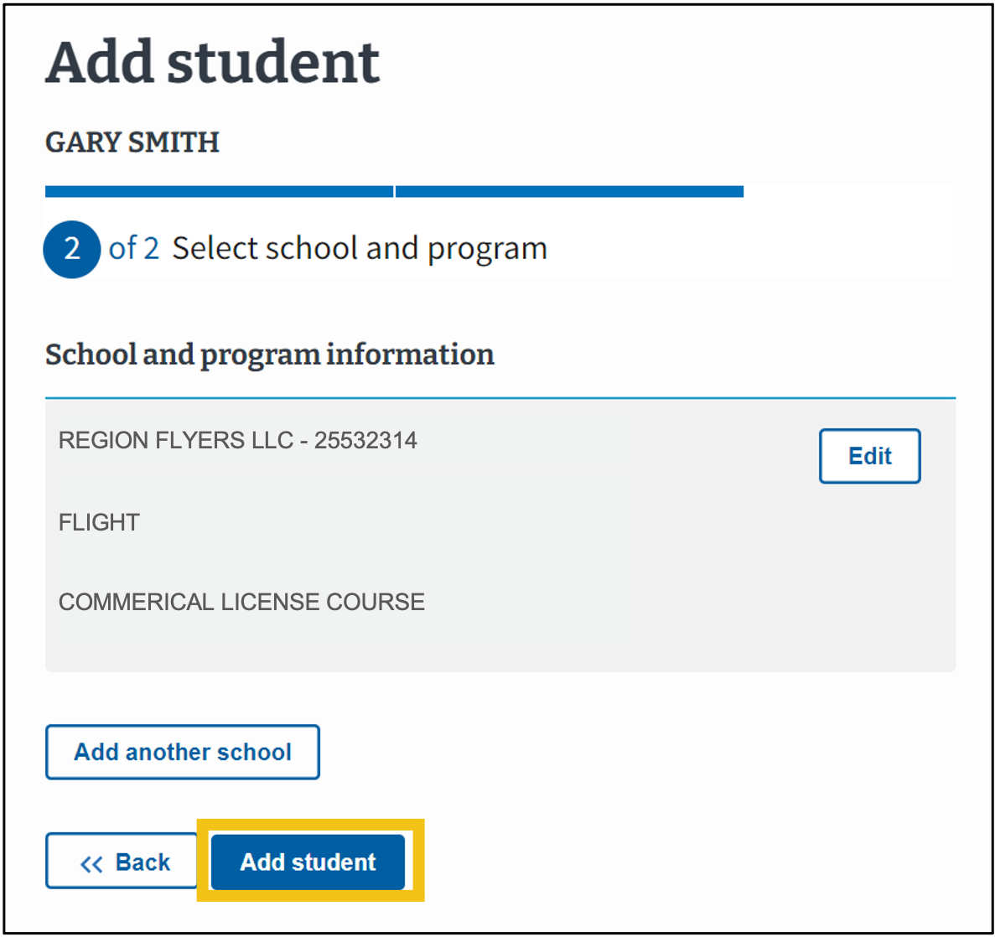
Flight: EM View of Creating a Student (continued 1)
Select the School the student is enrolled at. The dropdown contains the SCO’s assigned facilities.
C.
Select the dropdown menu to select “Flight” as the type of training.
C
D
D.
Select the dropdown menu to select the Program name.
Select “Save.”
Select “Add student” to finalize.
Return to Table of Contents
Return to Start of Flight Section

Slide 98
Flight: EM View of Creating a Student (continued 2)
The student’s information is now available in EM. From here, you will be able to add an enrollment.
ORVILLE WRIGHT
Return to Table of Contents
Return to Start of Flight Section

Slide 99
Return to Table of Contents
Flight
VA Form 22-1999 Side B –
VA Enrollment Certification
Submitting an Enrollment
Return to Start of Flight Section

Slide 100
Flight: VA Form 22-1999 Side B vs EM Functionality Submitting an Enrollment
Flight: VA Form 22-1999 Side B vs EM Functionality
This section outlines how to submit an enrollment certification. Begin with the table below to identify the task as it is completed using VA Form 22-1999 Side B and how the task is completed in EM. Each numbered task aligns with the numbered items in the pages that follow. Note: Regardless of training type, you must submit an enrollment before you can add monthly hours.
# | Task | VA Form 22-1999 Side B | EM – FLIGHT
1 | Student Information | SCOs wrote a student’s name and current address on the form. | Located at the top of the screen, EM automatically populates the student’s name after a student is created. The address is located on the right-hand bottom side of the screen.
2 | Begin Date for Courses/Class of Medical Certificate | SCOs wrote the begin date, class and date of last exam for the courses a student was completing. | SCOs select the calendar icon to select the appropriate begin and exam date for student courses. Additionally, SCOs must enter the “Medical certificate type”. Note: The student’s begin date is the date the student enrolls not the first day of the actual training.
3 | Courses Taken and Hours/Credit for Previous Training | SCOs wrote the number of hours of credit allowed for prior training and the number of hours in their current course for each type of training. | SCOs type the number of hours for each training type. SCOs also select the “Prior training time” dropdown menu and select the appropriate option.
4 | Total Charges | SCOs wrote the total charges. | SCOs type the total charges for training in EM.
5 | Remarks | SCOs wrote remarks concerning a student. | SCOs can choose to add a Custom Remark if needed. SCOs use the "Notes" section to capture student and facility specific information. Notes are not sent to VA with the enrollment but can be reviewed by VA, if necessary.
6 | SCO Certification | SCOs completed the form by certifying it by writing the appropriate information. | SCOs select the “Submit enrollment” button to submit the enrollment or select the “Save as draft” button.
Return to Table of Contents
Return to Start of Flight Section

Slide 101
Flight: VA Form 22-1999 Side B to EM Submitting an Enrollment
Flight: VA Form 22-1999 Side B to EM
The following section aligns with VA Form 22-1999 Side B actions for Submitting an Enrollment in EM.
Submitting Enrollments
Please note the following while reviewing this form:
“CTRL” + select the number associated with the field to navigate to the updated functionality in EM.
VA File Numbers/Social Security numbers (SSNs) are only used when creating a new trainee. SSNs cannot be edited or searched in EM. SSNs can only be viewed when printing the certification.
Type of Training automatically populates in EM based on the program selection.
Return to Table of Contents
Return to Start of Flight Section

Slide 102
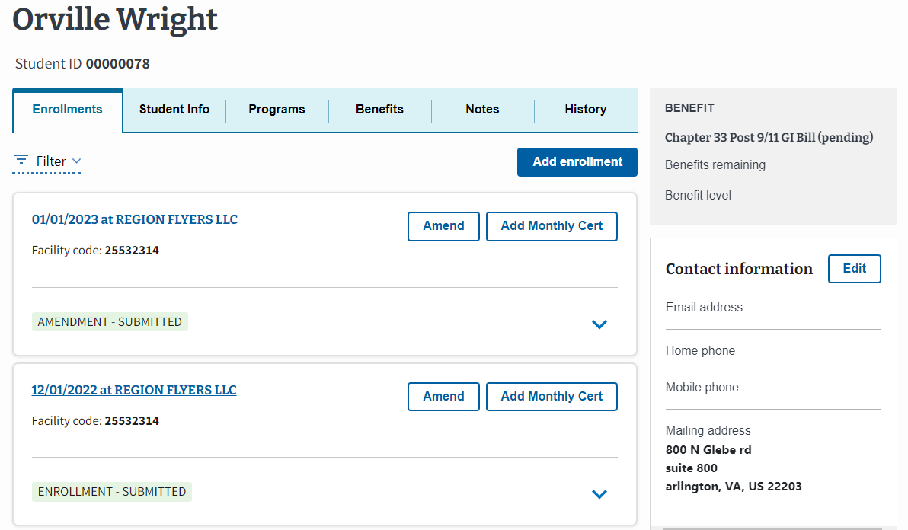
Flight: EM View of Submitting an Enrollment
Before submitting an enrollment, please review EM User Guide on the Resources for Schools for a step-by-step explanation on how to:
Enter flight instruction
Navigate to the Student Profile through searching for a student or creating a student
Once those actions are completed, select the “Add enrollment” button to start adding an enrollment.
1.
Located at the top of the screen, EM displays the trainee’s name once the trainee is created and/or found in EM and you navigate to that Student’s profile.
The student’s address is located on the right-hand bottom side of the screen.
Return to Table of Contents
Return to Start of Flight Section

Slide 103
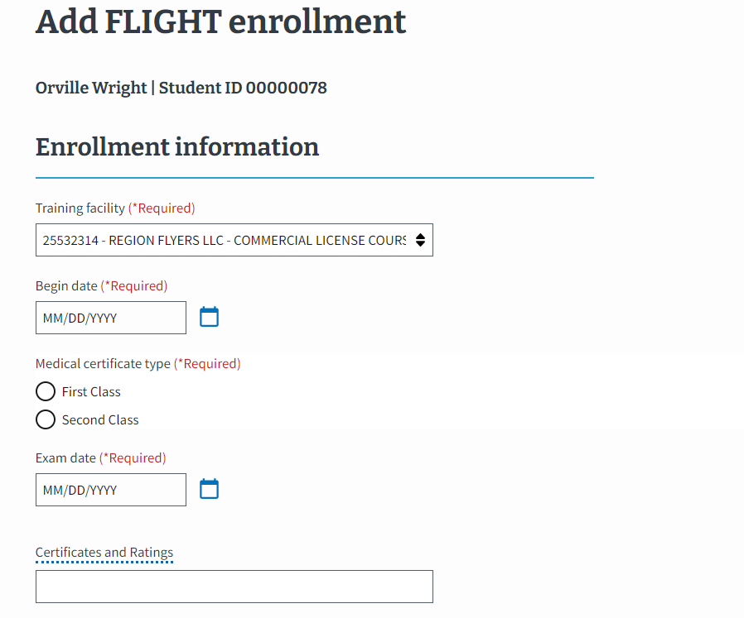
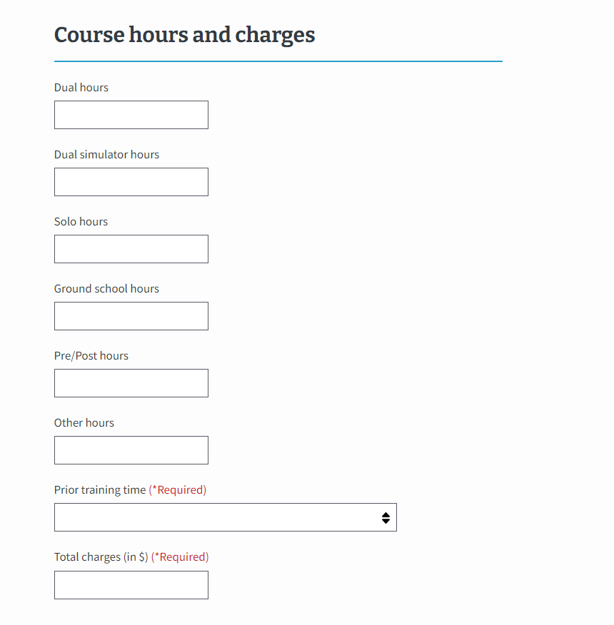
Flight: EM View of Submitting an Enrollment
SCOs must select the “Training facility” for the enrollment from the assigned facilities.
2.
Enter the appropriate “Begin date” for the student’s course. The student’s “Begin date” is the date the student enrolls, not the first day of the actual training.​ Select the appropriate “Medical certificate type” and enter the date of the student’s medical certificate in the “Exam date” box. The exam date must be before the begin date of the enrollment.
3.
Enter the number of hours completed for each type of training. SCOs also select the “Prior training time” dropdown menu and select the appropriate option.
4.
Type the total charges for training.
Return to Table of Contents
Return to Start of Flight Section

Slide 104
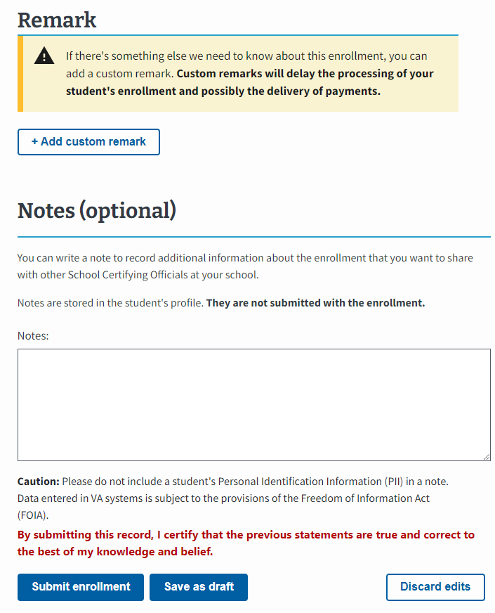
Flight: EM View of Submitting an Enrollment
5.
Add a Custom Remark if needed.
Use the "Notes" section to capture student and school specific information. Notes are not sent to VA with the enrollment but can be reviewed by VA, if necessary.
6.
Select the “Submit enrollment” button to submit the enrollment or select the “Save as draft” button.
Return to Table of Contents
Return to Start of Flight Section

Slide 105
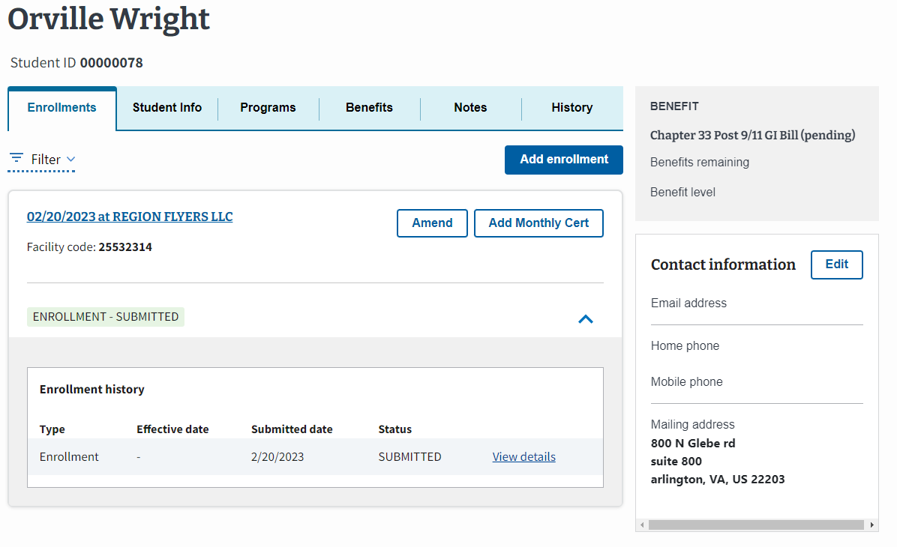
Flight: EM View of Submitting an Enrollment
A Success banner displays once the enrollment has been successfully submitted.
Return to Table of Contents
Return to Start of Flight Section

Slide 106
Flight
VA Form 22-6553c –
Monthly Certification of Flight Training
Return to Table of Contents
Return to Start of Flight Section

Slide 107
Flight: VA Form 22-6553c vs EM Functionality
This section outlines how to submit a monthly certification. Begin with the table below to identify the task as it is completed using VA Form 22-6553c and how the task is completed in EM. Each numbered task aligns with the numbered items in the pages that follow.
Note: SCOs cannot submit monthly hours until an enrollment is submitted that is equivalent to the originally submitted paper Side B VA Form 22-1999. Monthly Certifications submitted on paper must be resubmitted as Monthly Certifications in EM.
# | Task | VA Form 22-6553c | EM – Flight
1 | Student Information | SCOs wrote a student’s name and current address on the form. | Located at the top of the screen, EM automatically populates the student’s name after a student is created. The address is located on the right-hand bottom side of the screen.
2 | Reporting Period Dates | SCOs wrote the student’s reporting period begin and end date. | SCOs use the calendar icon to select the reporting period begin and end date.
3 | Reporting Completed Training | SCOs wrote the completed training during a reporting period. | SCOs select the “Add Flight Instruction” button to type the necessary data, e.g., “begin date, end date, category, flight, total cost, instruction, etc.
4 | Total Flight Costs | SCOs wrote the various costs. | EM automatically calculates total costs based on inputs to the Course hours and charges section.
5 | State and Local Taxes | SCOs wrote state and local taxes. | SCOs select the “state and local taxes apply to this period” checkbox and type the necessary data.
6 | Summary of Total Hours | SCOs wrote the total course hours through the end of a reporting period. | The total hours, including state and local taxes, automatically populates in the Cumulative box.
7 | Notes | SCOs wrote remarks concerning the student. | SCOs can choose to add a Custom Remark if needed. SCOs use the "Notes" section to capture student and facility specific information. Notes are not sent to VA with the enrollment but can be reviewed by VA, if necessary.
8 | SCO Certification | SCOs certified enrollment by signing and then submitting the completed form to VA. | SCOs select the “Submit certification” button to submit the certification or select the “Save as draft” button.
Return to Table of Contents
Return to Start of Flight Section

Slide 108
Flight: VA Form 22-6553c
This image represents the fields completed by SCOs submitting paper monthly certifications for Flight schools.
Please note the following while reviewing this form:
“CTRL” + click the number associated with the field to navigate to the updated functionality in EM.
Name of Current Course does not directly align to an EM field, since the SCO designated the course when creating or adding the student.
8
Return to Table of Contents
Return to Start of Flight Section

Slide 109
Flight: EM View of Adding a Monthly Cert
To learn how to navigate to the Student Profile, go to the EM User Guide on the Resources for Schools page.
To add a monthly certification, select the “Add Monthly Cert” button.
1.
Located at the top of the screen, EM displays the student’s name once the trainee is created and/or found in EM and you navigate to that Student’s profile.
The address is located on the right-hand bottom side of the screen.
Return to Table of Contents
Return to Start of Flight Section

Slide 110
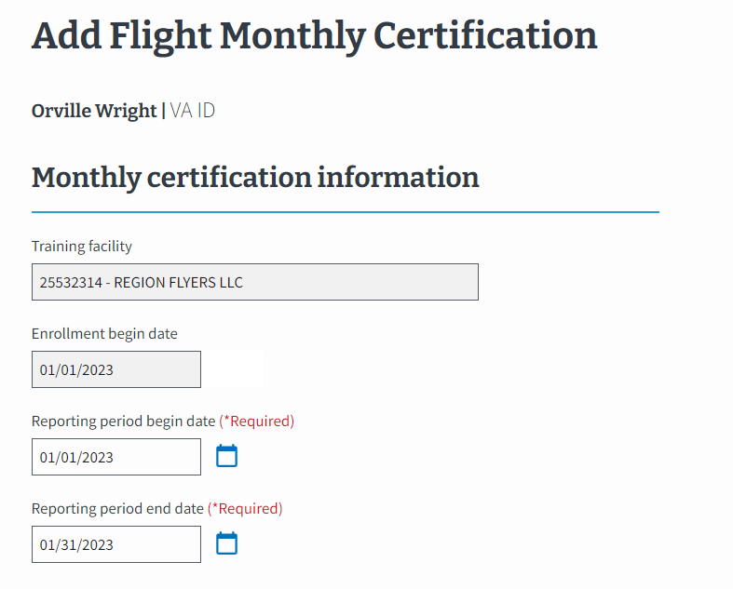
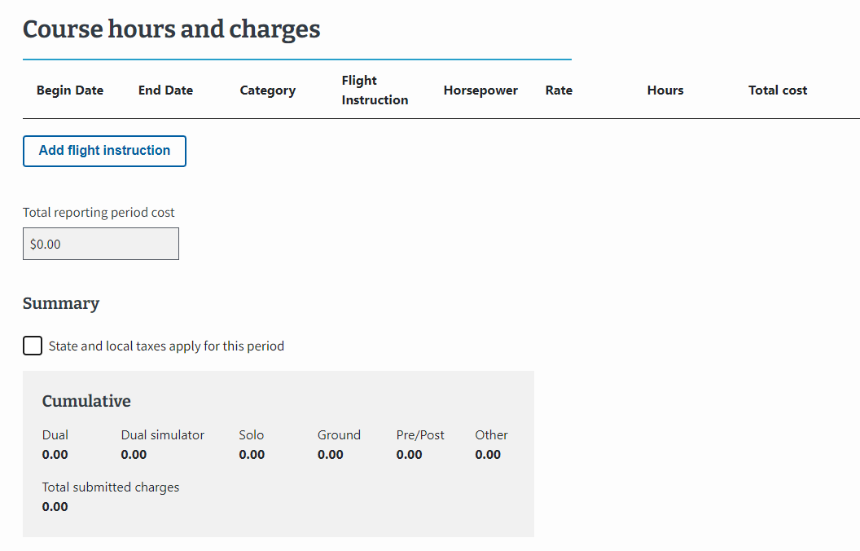
Flight: EM View of Adding a Monthly Cert (continued 1)
2.
For the first monthly certification, the “Reporting period begin date” auto populates to the first day of the enrollment. For all subsequent monthly certifications, the “Reporting period begin date” defaults to the first day of the month. The “Reporting period end date” defaults to the last day of each month.
3.
Select the “Add Flight Instruction” button to type the necessary data, e.g., begin date, end date, category, flight instruction, total cost, etc.
4.
EM automatically calculates total costs based on inputs to the Course hours and charges section.
5.
Select the “state and local taxes apply to this period” checkbox and type the necessary data.
6.
The total charges, including state and local taxes, automatically populates in the Cumulative box.
Return to Table of Contents
Return to Start of Flight Section

Slide 111
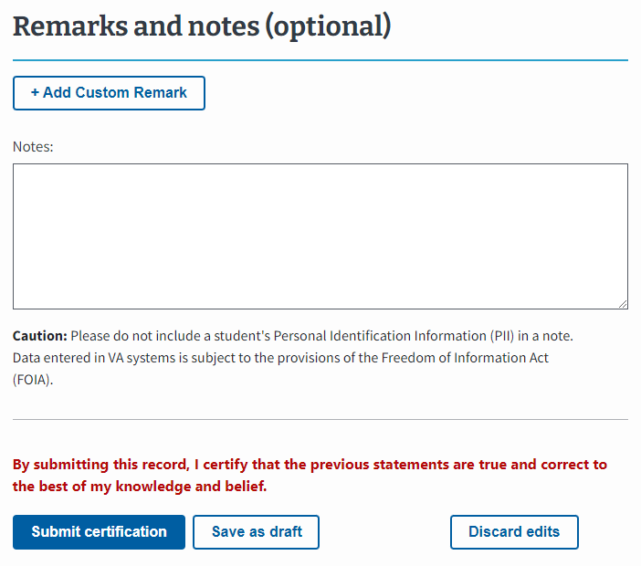
Flight: EM View of Adding a Monthly Cert (continued 2)
7.
Add a Custom Remark if needed.
SCOs use the "Notes" section to capture student and facility specific information. Notes are not sent to VA with the enrollment but can be reviewed by VA, if necessary.
8.
Select the “Submit certification” button to submit the certification or select the “Save as draft” button.
8
Return to Table of Contents
Return to Start of Flight Section

Slide 112
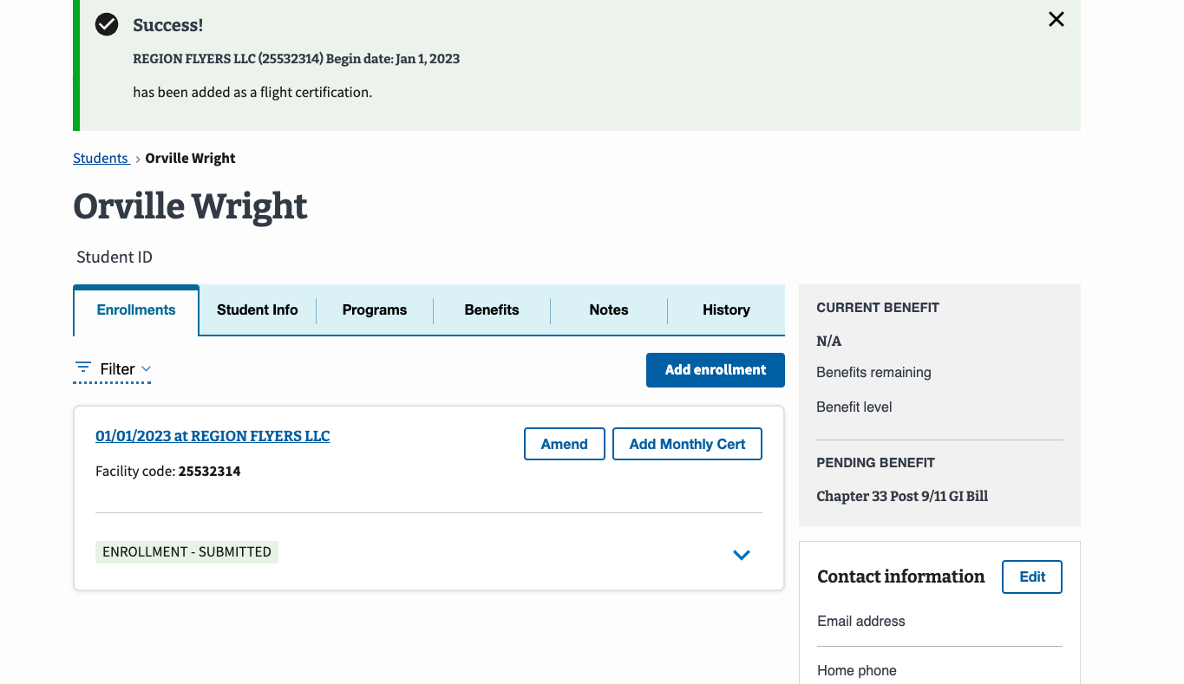
Flight: EM View of Adding a Monthly Cert (continued 3)
A Success banner displays once the certification has been successfully submitted.
Return to Table of Contents
Return to Start of Flight Section

Slide 113
Flight
VA Form 22-1999b–
Notice of Change in Student Status
Return to Table of Contents
Return to Start of Flight Section

Slide 114
Flight: VA Form 22-1999b vs EM Functionality
This section outlines how to end an enrollment. IMPORTANT: there is no equivalent of VA Form 22-1999b in EM. An enrollment can only be ended using a monthly certification and should only be ended if the student completed the program. Begin with the table below to identify the task as it is completed using VA Form 22-1999b and how the task is completed in EM. Each numbered task aligns with the numbered items in the pages that follow.
# | Task | VA Form 22-1999b | EM – Flight
1 | Student Information | SCOs wrote a student’s name and current address on the form. | Located at the top of the screen, EM automatically populates the student’s name after a student is created. The address is located on the right-hand bottom side of the screen.
2 | Ending an Enrollment Information/ Amendment Reason | SCOs selected the termination reason check box and wrote the last date of attendance. | SCOs enter a “Reporting period end date” that is prior to the last date of the month. This triggers the SCO to provide a reason for ending the enrollment. Select the “Completed training” option from the dropdown.
3 | Remarks | SCOs wrote remarks concerning a student. | SCOs can choose to add a Custom Remark if needed. SCOs use the "Notes" section to capture student and facility specific information. Notes are not sent to VA with the enrollment but can be reviewed by VA, if necessary.
4 | SCO Certification | SCOs completed the form by certifying it by writing the appropriate information. | SCOs select the “Submit enrollment” button to submit the enrollment or select the “Save as draft” button.
Return to Table of Contents
Return to Start of Flight Section

Slide 115
Flight: VA Form 22-1999b
This image represents the form completed by SCOs ending an enrollment for Flight schools.
Please note the following while reviewing this form:
“CTRL” + click the number associated with the field to navigate to the updated functionality in EM.
VA File Numbers (Box 2 on 22-1999b) are only used when creating a new Chapter 35 students. VA File Numbers can only be viewed when completing the actions to print a certification.
Social Security numbers (SSNs) (Box 4 on 22-1999b) are only used when creating a new trainee. SSNs cannot be edited or searched in EM. SSNs can only be viewed when printing the certification.
Return to Table of Contents
Return to Start of Flight Section

Slide 116
Flight: EM View of Ending an Enrollment
To learn how to navigate to the Student Profile, go to the EM User Guide on the Resources for Schools page.
To end an enrollment, select the “Add Monthly Cert” button.
1.
Located at the top of the screen, EM displays the student’s name once the trainee is created and/or found in EM and you navigate to that Student’s profile.
The student’s address is located on the right-hand bottom side of the screen.
Return to Table of Contents
Return to Start of Flight Section

Slide 117
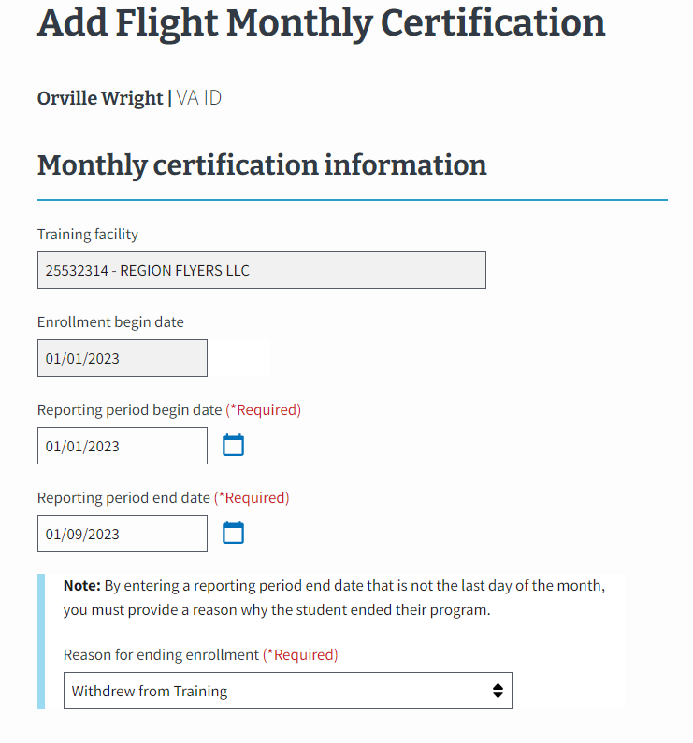
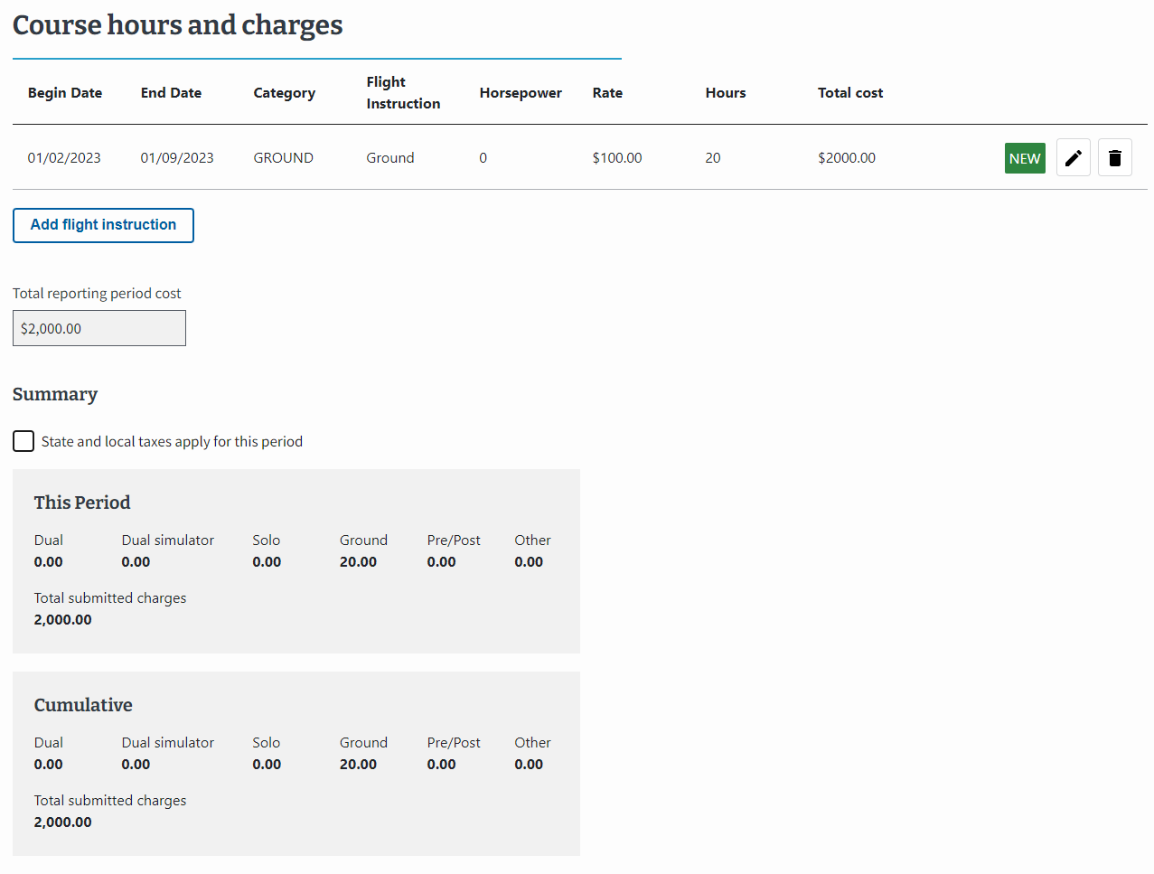
Flight: EM View of Ending an Enrollment (continued 1)
2.
Select the student’s last day of training for the “Reporting period end date” to trigger ending the enrollment.
Note: This date must not be the last day of the month to trigger the “Reason for ending enrollment” field to appear.
A new dropdown appears, and you can select “Completed training” as the reason for ending an enrollment.
Please only end an enrollment if the student completed the training program. Do not end an enrollment for any other reason.
Return to Table of Contents
Return to Start of Flight Section

Slide 118
Flight: EM View of Ending an Enrollment (continued 2)
3.
Add a Custom Remark if needed.
SCOs use the "Notes" section to capture student and facility specific information. Notes are not sent to VA with the enrollment but can be reviewed by VA, if necessary.
4.
Select the “Submit certification” button to submit the certification or select the “Save as draft” button.
Return to Table of Contents
Return to Start of Flight Section

Slide 119
Flight: EM View of Ending an Enrollment (continued 3)
A Success banner displays once the certification has been successfully submitted.
Return to Table of Contents
Return to Start of Flight Section

Slide 120
End of Flight section.
Congratulations!
This is the end of the instructions for the selected facility type.
Select here to navigate to the Helpful Resources section.
Return to Table of Contents
Return to Start of Flight Section

Slide 121
Additional Resources
Return to Table of Contents

Slide 122
Additional Resources List
EM Resources
EM FAQs
Multi-Factor Authentication Video
ID.me And Login.gov Resources
ID.me Help Center
VA.gov Resources and Support
VA & ID.me – ID.me Help Center
School Certifying Official Resources
Take the following courses in the SCO Training Portal:
EM 100
EM 101
EM 102
Final Assessment
Monthly Office Hours
Monthly Office Hours Q&A
EM User Guide on the Resources for Schools
Return to Table of Contents

Slide 123
End

