Slide 1
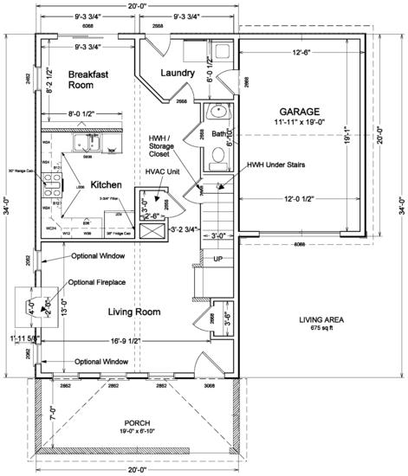
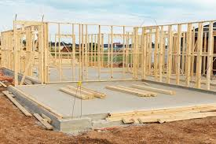
Construction to Permanent Home Loan
Notes:
Thank you, Molly – and welcome everyone – I’m truly grateful for the opportunity to talk to you today about an exceptionally valuable benefit – the VA-guaranteed Home Loan benefit.
I think it’s always helpful for the audience to have some background on the presenter, so I’d like to briefly introduce myself.
I retired with just over 21 years from the Air Force – I spent half that time enlisted and half as a commissioned officer. Following retirement, I went to work with the Small Business Administration – on their Disaster side, and was deployed to NY following 9/11 to process loans for businesses affected by the disaster. I then obtained my Certified Financial Planner – or CFP – designation and worked in the financial planning industry for a few years before taking a position with VA at our Houston Regional Loan Center. For the past 8 years, I’ve worked our Central Office in Washington, DC – first on the Policy staff and now in my current role as Lender Liaison.

Slide 2
Circular 26-18-7 Policy
Title 38 USC § 3710 (a)(1)(3) provides VA the authority to guaranty loans for the construction of a home to be owned and occupied by a Veteran.
The loan is closed prior to the start of construction with proceeds disbursed to cover the cost to build, cost of the land, or balance owed on the land, with the remaining balance in escrow.
The remaining balance to be disbursed during construction may also be referred to as a Loan in Process (LIP) account, or a Draw account.
The lender must obtain written approval from the borrower before each disbursement, or draw payment is provided to the builder.
This is a construction loan where the home is being built by using funds secured by the Veteran

Slide 3
Appraising Based on Construction Loans
Lenders need to consider; how will the Appraiser know this is a construction loan and not a typical Purchase Loan?
Communicate with the appraiser to find out what is needed to provide to fulfill the appraisers scope of work.
All the documents should be made available ahead of time.
Most construction loans obtain a value prior to foundation.
When the property is complete, the lender will contact the original VA appraiser to complete the VA final inspection.
The VA final inspection is to certify all VA MPRs are met and the house was built to the original plans, specifications and approved change orders, and that the as-completed value from the appraisal was maintained.

Slide 4
Appraising NON-Construction loans.
This been causing some issues in purchase of new homes.
Appraisals for purchase of new homes built by production builders where the builder using their own money has not changed. (Funding by the builder)
All VA guidance still applies for new builder homes that are not construction loans.
Can be valued based on Model homes. See Chapter 10 section 13.

Slide 5
Eligible VA Loan Types
One-time close (or single close) construction loans
These types of loans are used to close both the construction loan and permanent financing at the same time.
The permanent financing is established prior to construction, and the final terms are modified to the permanent terms at the conclusion of construction.
Two-time close construction loans
Two-time close loans generally involve an initial loan closing prior to the commencement of construction, and a second closing where permanent financing is used to take out, or replace the initial loan.

Slide 6
Transaction types
Transactions in which a Veteran has signed a contract to build will be considered a purchase, regardless of the category shown on the closing disclosure, unless otherwise stated below.
The lender must order the case as “new construction and purchase”
Transactions in which a Veteran acted as their own contractor, and/or hired subcontractors may be considered a purchase.

Slide 7
The Process: One time close
COE
Qualify the Borrower(s)
Order Appraisal (communication is essential)
Issues NOV
Pay the funding fee
Close the Loan (in the same manner you ordered it)
Construction takes place
Final Inspection/CO
Modify the loan
Guaranty the loan as a purchase.

Slide 8
The Process: Two time close
COE
Qualify the borrower(s)
Order the appraisal (communication is essential)
Issue NOV
Close the initial Loan with NON-VA financing
Complete construction
Qual the borrower(s) again
Order the appraisal if appropriate
Issue NOV if appropriate
Close the loan
Pay the funding fee
Guaranty the loan as a purchase.

Slide 9
Allowable Builders
The general contractor must be a registered VA builder.
For any property appraised for proposed construction, the builder or contractor must have a valid builder identification number prior to a VA NOV being issued.
Borrowers are free to choose their builder or contractor, subject to any additional requirements the lender may require.
It is the lender’s responsibility to ensure that the builder or contractor is licensed, bonded, and insured according to all state and local requirements.

Slide 10
Change Orders
Change orders/upgrades made after the appraisal cannot be mortgaged into the new loan.
Change orders must be approved, in advance, by the appraiser, to ensure no loss (change) in value.
The Veteran is allowed to pay for an additional appraisal if change orders are to be mortgaged into the new loan.

Slide 11
Project management
The lender is responsible for all aspects of establishing the account containing the construction funds.
The lender must ensure that funds are accounted for, and disbursed according to the progress completed.
Any remaining funds in the LIP account upon completion should be disbursed according to the contract. If the remaining funds are the borrowers, re-imbursement is acceptable up to the verified amount that has been paid in advance; otherwise the funds must be applied to the loan balance.
In addition, the lender has the responsibility to evaluate, monitor, and manage the project.

