Slide 1
VA 2019 Lenders Conference Federal Lending Update
Brian Chappelle
Potomac Partners
April 24th, 2019

Slide 2
Overview
Positive Economic Environment
President’s Plan To Reform Housing Finance System
Federal Lending Update

Slide 3
What Makes VA Home Loan Program Unique/Special
As Jeff said yesterday, VA’s guiding principle:
“Veteran Centric”
Loan guaranty is part of veteran’s benefits
Has separate Congressional Committees
Long-standing Objective: Help servicemen & women/veterans adjust to civilian life
Have legislative, oversight, and investigative jurisdiction over the education, employment and training of veterans, and veteran housing programs
Has been “fully funded” during recent shutdowns
Helps to keep Ginnie Mae operational

Slide 4
Positive Economic Environment
Waiting for April “jobs” report next week
Impact of global slowdown
Fed will likely continue to “err” on side of caution
Recognizes the importance of housing to consumers and consumers to the economy
Demographic factors remain very encouraging

Slide 5
Encouraging Demographics
Population and Its Characteristics Define the Future
Source: US National Center for Health Statistics

Slide 6
President’s Plan To Reform Housing Finance System
Goals
Reduce taxpayer risk
Expand private sector’s role
Modernize government programs
Make sustainable homeownership benchmark for success
Directs Treasury & HUD to develop plans
Treasury – responsible for Fannie Mae & Freddie Mac
HUD – responsible for FHA & Ginnie Mae
Timing
Develop leg. & admin. plans “as soon as practicable”
Consult w/ VA Secretary & other agency heads
New FHFA Director pledged “great sense of urgency”

Slide 7
Treasury’s Goals Fannie Mae & Freddie Mac
End the conservatorships of the GSEs
Facilitate competition in the housing finance market
Minimize risks GSEs pose to the financial stability of the United States
Ensure Government is “properly compensated for any explicit or implicit support” it provides to the GSEs or the secondary mortgage market.

Slide 8
Treasury’s Proposals Should Achieve Following Objectives
Preserve access for qualified homebuyers to 30 year fixed-rate & other appropriate loans
Maintain equal access to system for lenders of all sizes, charter types, and locations
Increase competition and participation of the private sector in the mortgage market
Mitigate the risks by altering, if necessary, their respective policies on loan limits, program and product offerings and credit underwriting
Evaluate QM “patch” w/ HUD & CFPB

Slide 9
Fannie Mae & Freddie Mac Today
Finances
Paid $4.7 billion to Treasury this quarter
Have paid $297 billion since housing crisis
Many operational improvements
Day One Certainty is growing – reducing repurchase risk
VA’s VALERI upcoming changes
Steady increasing use of technology - eClosings
Borrowers can review loan documents prior to closing.
Faster and easier signing process.
More informative and efficient than a traditional closing.

Slide 10
HUD’s Goals: FHA & Ginnie Mae
Attempt to ensure that the FHA and GNMA assume primary responsibility for:
Lending to low- and moderate-income families that cannot be fulfilled through traditional underwriting
Reduce taxpayer exposure
Improved risk management
Program and product design
Modernize the operations and technology of the FHA and GNMA

Slide 11
HUD’s Proposals Should Achieve The Following Objectives
FHA
Address financial viability of HECM program
Assess the risks and benefits associated with providing assistance to first-time homebuyers, including down-payment assistance
Increase bank participation
Ginnie Mae
Enhance issuer oversight to ensure its safety and soundness and protect borrower/investor interests
Reduce abusive and unsound loan origination or servicing practices in the GNMA program

Slide 12
What Will Housing Reform Mean?
Memo “tone”: reduce government role & risk
Any changes will take time
Since legislation is unlikely, administrative reforms (i.e. do not need legislation) are more likely alternatives
Loan Limits
Fees
Products
Debate about role in government in housing
Government “footprint” vs. costs
VA Home Loan Program should not be directly affected

Slide 13
FHA
President’s memo “explains” why FHA premium has not been lowered
Concerned about potential risks to taxpayer
FHA finances keep getting stronger
“Earned” $7 billion in 2017 - $8 billion in 2018
Focus on origination risks
Recent TOTAL Scorecard change
Credit scores < 620 & DTIs > 43% = manual u/w
What changes are possible/likely?

Slide 14
HUD Statements on Risk
Last October, Advance Notice of Proposed Rulemaking (ANPR) was announced:
Amount and source of borrower’s cash investment
Gift source – other than family (gov. entities & nonprofits)
Use of seller concessions/interested third-parties
LTV and total DTI ratios & borrower “characteristics”
Use of cash-out refinancing
Still waiting for ANPR
FY 2018 Annual Report to Congress
Reiterated the above concerns
Decline in bank participation
Mentioned appraisal concerns in press briefings

Slide 15
FHA: Possible/Likely Changes?
Address concerns about bank participation
DOJ Memorandum of Understanding expected “soon”
“Revisiting” lender certification requirements
Will solicit industry input
Downpayment assistance
Expect rulemaking – “self-identified government entities”
Cash-out refinance changes
Policy vs. performance issue

Slide 16
FHA Issues
DACA
Recent press reports have created a lot of confusion
At a recent Congressional hearing, HUD Secretary Carson emphasized that FHA will follow the law.
HUD interprets the law as follows:
Borrowers w/ DACA status are not eligible for FHA insurance (unlike recent Fannie Mae change)
Handbook (p.134) states:
Non-U.S. citizens without lawful residency in the U.S. are not eligible for FHA-insured Mortgages.
FHA is requiring indemnifications in PETR reviews
Final condominium rule
Sent to OMB for review – final major step

Slide 17
VA “Operational FAQs”
Escalation Protocols
Reminder: RLC staff have same material that you have (law, regulations, handbook & circulars)
Ask your loan specialist to escalate issue to LPO/ALPO
DO NOT ASK ANOTHER RLC
If you still have a question, elevate to Headquarters
Allowable charges and fees
Look at Regulation: Section 36.4312
Link: https://www.gpo.gov/fdsys/pkg/CFR-2009-title38-vol2/pdf/CFR-2009-title38-vol2-sec36-4312.pdf
Chapter 8 of Lender Handbook
Notes:
s

Slide 18
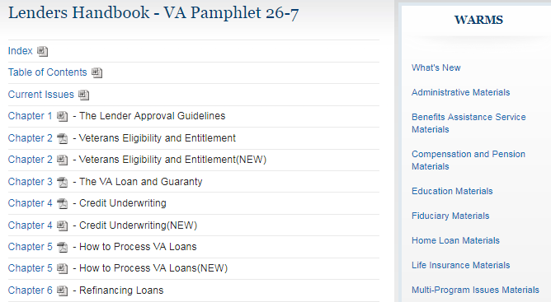
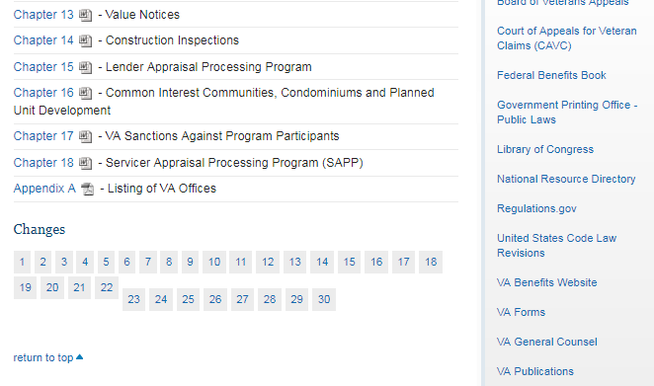
VA Lender Handbook Changes

Slide 19
VA “Operational FAQs”
VA Lenders Handbook: Change “Highlights”
Look at “Changes” at the bottom of the web page
2019 changes
Change 23: Chapter 1 – Effective date - February 1st
Change 24: Chapter 11 – Change date – February 22nd
Change 25: Chapter 4 – Change date – February 22nd
Change 26: Chapter 10 – Change date – March 11th
Change 27: Chapter 7 – Change date – March 11th
Change 28: Chapter 2 – Change date - March 28th
Change 29: Chapter 12 – Change date – March 28th
Change 30: Chapter 5 – Change date – April 1st
Implementation - 90 days after “change date”

Slide 20
Ginnie Mae: APM 19-03
“Seasoning” Clarification
No seasoning requirement
Loans refinancing non-mortgage debt
New construction structured as a “purchase” not refinance
Loans w/o scheduled monthly payments
Modified loans
Seasoning requirement still applies to
Refinances of non-VA loans (e.g. FHA, USDA, Fannie or Freddie)
Re-performing refinance loans
Trigger is MBS issuance date not any loan transaction date

Slide 21
Summary
Positive economic environment for mortgage originations
Impact of President’s Request for Plans on Reforming Housing Finance System
Watch for possible administrative changes
Mortgage market in 2019
Good economy + lower interest rates = strong mortgage market
VA home loan program is a benefit program

