Slide 1
Chapter 6
Interest Rate Reduction Refinance Loans
Presented by:
Greg Nelms, Chief, Loan Policy, Washington DC
Amy Berumen, Loan Production Officer, Phoenix RLC

Slide 2
Policy Updates
  QM requirements were incorporated
  New examples for payment decrease/increase requirements
  Recoup Calculation clarified
  FAQs on Circular
  Future System Enhancements
  Misleading Advertising

Slide 3
Qualified Mortgage (QM)
Typically all VA loans are considered to have Safe Harbor QM status.
IRRRLs must also meet requirements of 38 CFR § 36.4300(c)(1)
6 months seasoning
Recoup of 36 months or less
  Excludes: EEMs, Adjustable Rate to Fixed Rate, Reduced Term
Requirements related to exemption of income verification is satisfied
  Current loan is not 30 days or more past due
  IRRRL does not increase PB on existing loan except for EEMs and allowable fees and charges
  Total points and fees (TILA) do not exceed 3% of proposed principal amount
  Lower interest rate (unless adjustable to fixed)
  Fully amortize loan (no balloon payments)
  Both original and new loan satisfy all other VA requirements
Notes:
Or Lender verifies income in accordance with VA’s UW requirements.

Slide 4
QM Requirements Cont.
Not Safe Harbor QM --> Rebuttable Presumption QM
  Does not require VA Prior Approval!
Prior approval only required when loan is 30 days or more past due
  Not required for NSC Pension and Fiduciary cases
  VA’s prior approval does not mean loan is considered Safe Harbor
ANY loan where new payment (PITI) increases by 20% or more requires Lender Certification (signed by Underwriter)
  Determine income established is stable and reliable,
  Borrower(s) qualify for new payment

Slide 5
Payment Decrease/Increase Requirements
Allowed or Not Allowed?
1) Current loan 5% fixed; New loan 4% ARM – payment decreased
2) Current - 30 yr. fixed at 4%; New - 3.5% fixed for 25 yrs.
3) Current - 30 yr. fixed at 4%; New - 4% fixed for 15 yrs.
4) Current - 30 yr., 3.5% ARM (original rate 2.5%); New - 30 yr. fixed at 4%
5) Current - 3.5% fixed with 15 yr. term; New - is 3.25% fixed for 30 yrs.
✓
✓
X
✓
X

Slide 6
Recoup Statement
Purpose: To allow Veterans to make better informed decisions in regard to IRRRL refinances.
VA Circular 26-18-1
  Effective for all loans closed on or after April 1, 2018
  Requires two Recoup Statement disclosures
    On lender’s letterhead
    Initial - within 3 business days of loan application
    Final - prior to closing, must be signed by the Veteran
  Starting May 21, 2018, Lenders upload into WebLGY:
    Both recoup statements
    Lenders Certification (as applicable, payments increased by 20% or more)
    VA Form 26-8923, IRRRL Worksheet

Slide 7
Calculating the Initial Recoup
Using the LE
Add: A, B, C, E, H
(include VAFF)
$2,179
Subtract: Lender
Credits (J)
$200
= Total Costs
$1,979
Divide by decrease in
monthly payments
$50
TOTAL Months to
Recoup: 35.98

Slide 8
Calculating the Final Recoup
Use the CD
Lender Credits should be itemized in paid by Other column and not considered in the overall calculation

Slide 9
https://www.benefits.va.gov/HOMELOANS/lenders_samp_doc.asp

Slide 10
Frequently Asked Questions
Question 1: The Circular is effective with closed loans April 1, 2018. For loan in process that have not been disclosed what should our company do?
Answer: For loan applications impacted due to this timing, VA encourages lenders to make every effort to provide the Statement to the Veteran as soon as possible. If lenders are having difficulty complying, they should contact a VA Regional Loan Center (RLC) with Loan Guaranty operations by calling 1-877-827-3702 with hours of operation between 8am to 6pm EST. Your call will be placed in the national queue.
Question 2: Will WebLGY change due to this new policy VA is implementing?
Answer: Full functionality will be available for lenders to certify and upload the disclosures in WebLGY on May 21, 2018. For loans guaranteed on April 1 and prior to May 21, 2018, lenders will not be required to upload the disclosures; however, lenders may be asked to produce those documents in an onsite audit, or a file review audit.
Question 3: Since the Circular states that the Lender’s Certification must be provided at the time of initial disclosure if the payment increases 20% or more. How can we provide that certification, which is attesting that the veteran qualifies for the PITI increase, when we have not underwritten the file?
Answer: This requirement has been removed from the initial disclosure period. The lender will be required to provide the Lender’s Certification for payment increases 20 percent or more at closing, and will also be required to make this same certification in the Loan Guaranty Certificate (LGC) process.

Slide 11
Frequently Asked Questions
Question 4: Please confirm when it is required that the Veteran’s Statement is to be signed by the Veteran.
Answer: It is preferred that the Veteran acknowledge, by signature, the Statement provided in the initial disclosure package, it is understood that these actual documents are not always returned to the lender. VA does expect the lender to be able to show the disclosure statement at a minimum was sent and received by the Veteran. It is also a requirement that the Veteran acknowledge by signing the final Statement with the closing documents. In the file review process, VA will review the date on the initial Statement with the Loan Estimate to ensure it was disclosed timely.
Question 5: In our disclosures the Veteran’s Statement and Lender Certification are two separate documents. Is this acceptable?
Answer: Yes
Question 6: Will Lenders be required to send subsequent statements or certifications when the loan attributes (that impact the recoupment period) change during processing?
Answer: VA understands that variance exists in an initial application and a final application and is not requesting lenders to provide updated disclosure(s) during the loan process.

Slide 12
Frequently Asked Questions
Question 7: Do escrows of property taxes and insurance fall under the definition of taxes in (1) Origination charges, services you cannot shop for, services you can shop for, taxes and other government fees, other, or VA funding fee?
Answer: Property taxes do not fall under the description in 3. b. (1). Note: titles of the categories listed are identical to the titles on the Loan Estimate (LE). 3.b. (1) is referring to these title headings.
It is not necessary to include title headings F. Prepaids, and G. Initial Escrow Payment at Closing in the recoupment calculation.
Although the funding fee is often included in F. or G. of the LE or closing disclosure (CD), the funding fee should be included as a cost to be recouped regardless of where it is positioned on the LE or CD.
Question 8: Based on section 3.b. (1) of the circular it would appear that the fees would need to be itemized on the Veteran’s Statement based on the categories stated and the lump sum calculation of closing costs would no longer be acceptable?
Answer: The circular is giving lenders guidance on what to use in order to determine the total closings costs required for the recoupment calculation. It is acceptable to provide a lump sum of the total closing costs on the Veteran’s statement. It is also acceptable to itemize these charges on the Veteran’s statement, but it is not required.
This is not intended to give guidance on completing the CD. Guidance on completing the CD can be found in Circular 26-17-11, Instructions Regarding Documentation of Allowable Fees and Charges on the Truth in Lending Act- Real Estate Settlement Procedures Act (TILA-RESPA) Integrated Disclosure Closing Disclosure (TRID-CD Form) .

Slide 13
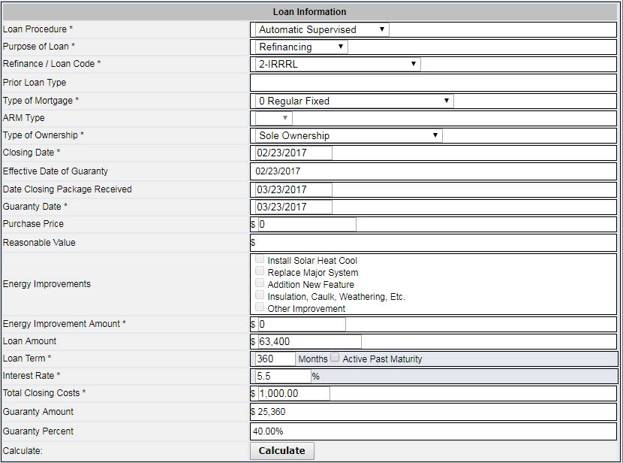
Future WebLGY Enhancement

Slide 14
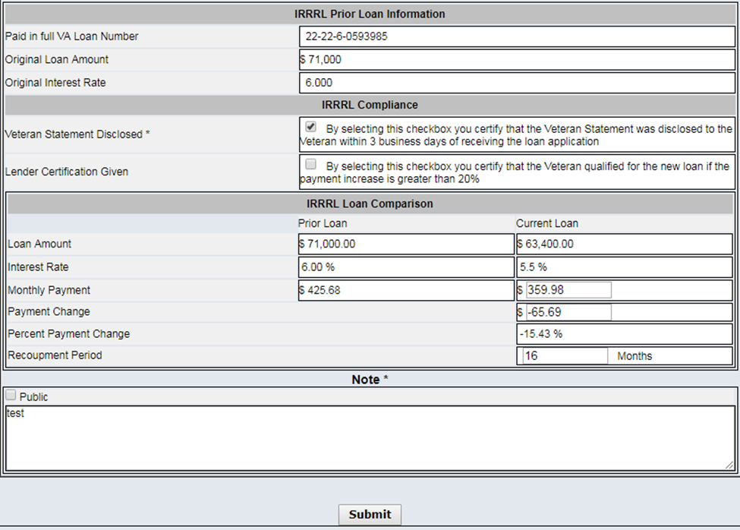
Certifications at Guaranty

Slide 15
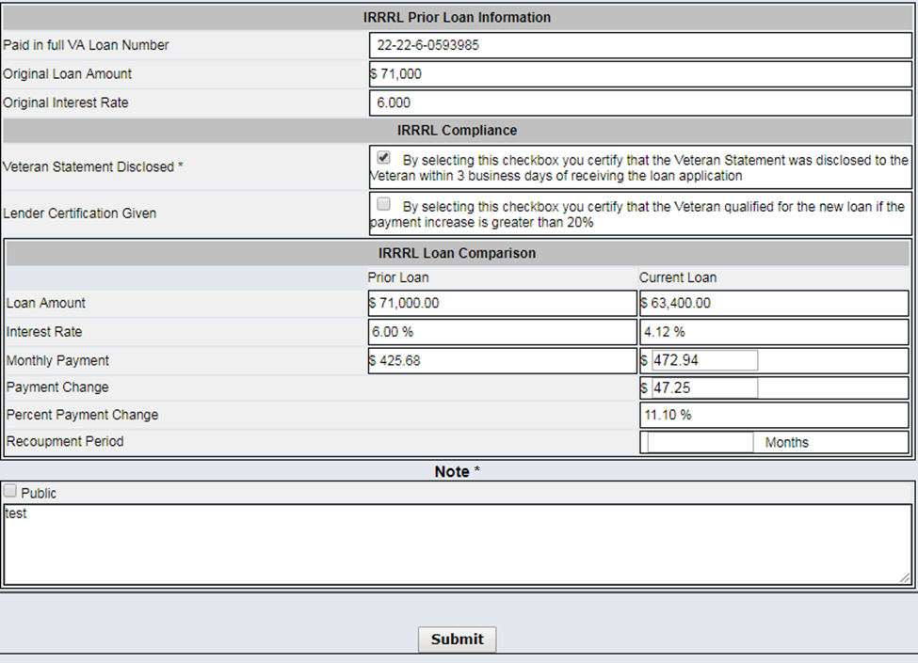
Certifications at Guaranty

Slide 16
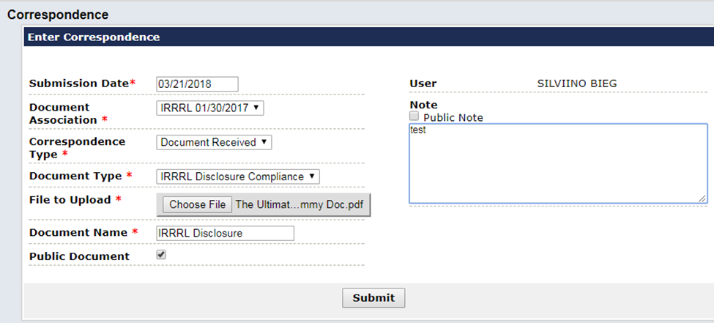
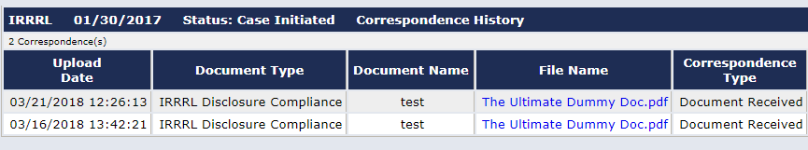
Uploading Disclosures

Slide 17
Potential Enhancements
  Establishment of Net Tangible Benefit
  Automation of the recoupment statement at IRRRL case number request
  Veteran immediately notified of case request and NTB
  Hard stop if conditions are not met

Slide 18
Misleading Advertising
  Offers to skip mortgage payments
  Offers to receive escrow refund
  Low-interest rates or low initial payments without specific terms
  Aggressive sales tactics
  Suggesting special relationship with VA that ONLY you (lender) can provide loan opportunity
  Use of VA logos or giving the appearance letters come directly from VA

