Slide 1
Alteration & Repair Loans
Presented by:
Greg Nelms, Chief, Loan Policy, Washington DC

Slide 2
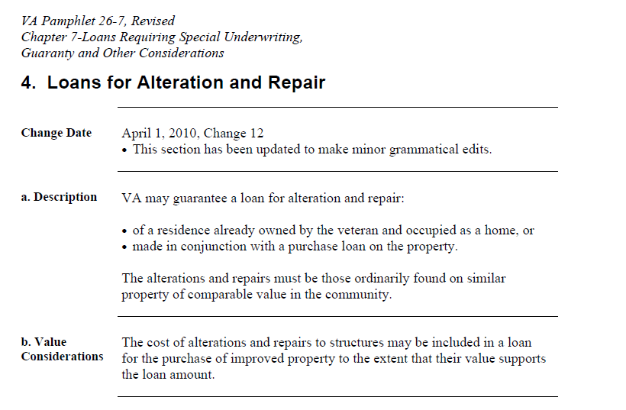
Policy Updates
VA Circular 26-18-xx
Replaces

Slide 3
Why?
Veteran choice
Difficulty buying fixer uppers that do not meet VA MPRs
Adaptations for future needs
Energy efficient improvements
Lack of new and existing home inventory
Rising prices and values
Aging housing stock
Notes:
Or Lender verifies income in accordance with VA’s UW requirements.

Slide 4
Highlights
Purchase and Refinance – Owner occupied only
Credit and Underwriting. Loans for alteration and repair are underwritten in accordance with Lenders Handbook, 26-7, Chapter 4
Property Eligibility and Appraisals. The property and appraisal requirements for alteration and repair can be found throughout Lenders Handbook, 26-7, Chapter 10 and 16.
Acquisition cost vs. As-completed value

Slide 5
Highlights
Fees and Charges. Lenders may charge the Veteran a construction fee of up to two percent of the amount of the loan for its services, provided that the major portion (51 percent or more) of the loan proceeds is paid out by them during the actual progress of the construction, alteration, improvement, or repair. Such charge may be in addition to the one percent origination charge. If the portion of disbursed proceeds for services is less than 51, a one percent or less construction fee is permissible in addition to the one percent origination charge.

Slide 6
Highlights
Purchase Examples:
Example A. Contract sales price $100,000, alterations and repairs $75,000, contingency reserve of $7,500, inspection $250, permit $250, for a total acquisition cost of $183,000. Notice of Value (NOV) is $180,000. The lesser amount of $180,000 is to be used as the acquisition cost and the borrower must bring $3,000 to closing. This is not considered downpayment as it is greater than the value.
Example B. Contract sales price $100,000 alterations and repairs $75,000, contingency reserve of $7,500 inspection $250, permit $250, for a total acquisition cost of $183,000. NOV is $190,000. The lesser amount of $183,000 is to be used as the acquisition cost. Therefore, the entire acquisition cost of $183,000 plus the funding fee may be financed.

Slide 7
Highlights
Refinance Examples:
Example A. Payoff $200,000, alterations and repairs $25,000, contingency reserve of $2,000, inspection $250, permit $250, for a total acquisition cost of $227,500. NOV is $220,000. The lesser amount of $220,000 is to be used as the acquisition cost and the borrower must bring $7,500 to closing, or reduce the project costs and obtain a reconsideration of value based on the adjusted alteration and repair costs.
Example B. Payoff $200,000, alterations and repairs $25,000, contingency reserve of $2,000, inspection $250, permit $250, for a total acquisition cost of $227,500. NOV is $230,000. The lesser amount of $227,500 is to be used as the acquisition cost and the borrower may finance the entire project cost of $227,500. In addition the borrower may finance closing costs, prepaids or take cash-out up to 100 percent loan to value.

Slide 8
Highlights
Contingency Reserve is allowed up to 15% of the alteration and repair costs (not a requirement).
Builder and Contractor Registration Requirements. For any property appraised for alteration and repair the builder or contractor must have a valid builder identification number prior to a VA NOV being issued. For information on obtaining a builder identification number see Lenders Handbook, 26-7, Chapter 10.
Project management is the responsibility of the lender

Slide 9
Highlights
Inspections. Improvements must be completed according to local building codes. The options allowable to satisfy the inspection requirement for cases ordered as “Proposed” are:
If the local authority performs the required inspections and issues a Certificate of Occupancy (CO) or equivalent, VA will accept the CO for the property as evidence of local authority inspections and satisfactory completion of construction. Loans for alteration and repair ordered as “Proposed” require local authority inspections according to the extent of the improvements and local requirements.
If the local authority performs the required inspections but does not issue a CO or equivalent, VA will accept copies of the inspection reports, which verify full compliance with local builder codes, or a written statement from the local authority that states that the required inspections were performed satisfactory.

Slide 10
Highlights
Final inspection: When the property is 100% complete, the lender will contact the original VA fee appraiser to complete the VA final repair inspection.
Guaranty. The guaranty for alteration and repair and loans will not be issued until a clear final inspection report has been completed by the VA fee appraiser.

